Slide 1
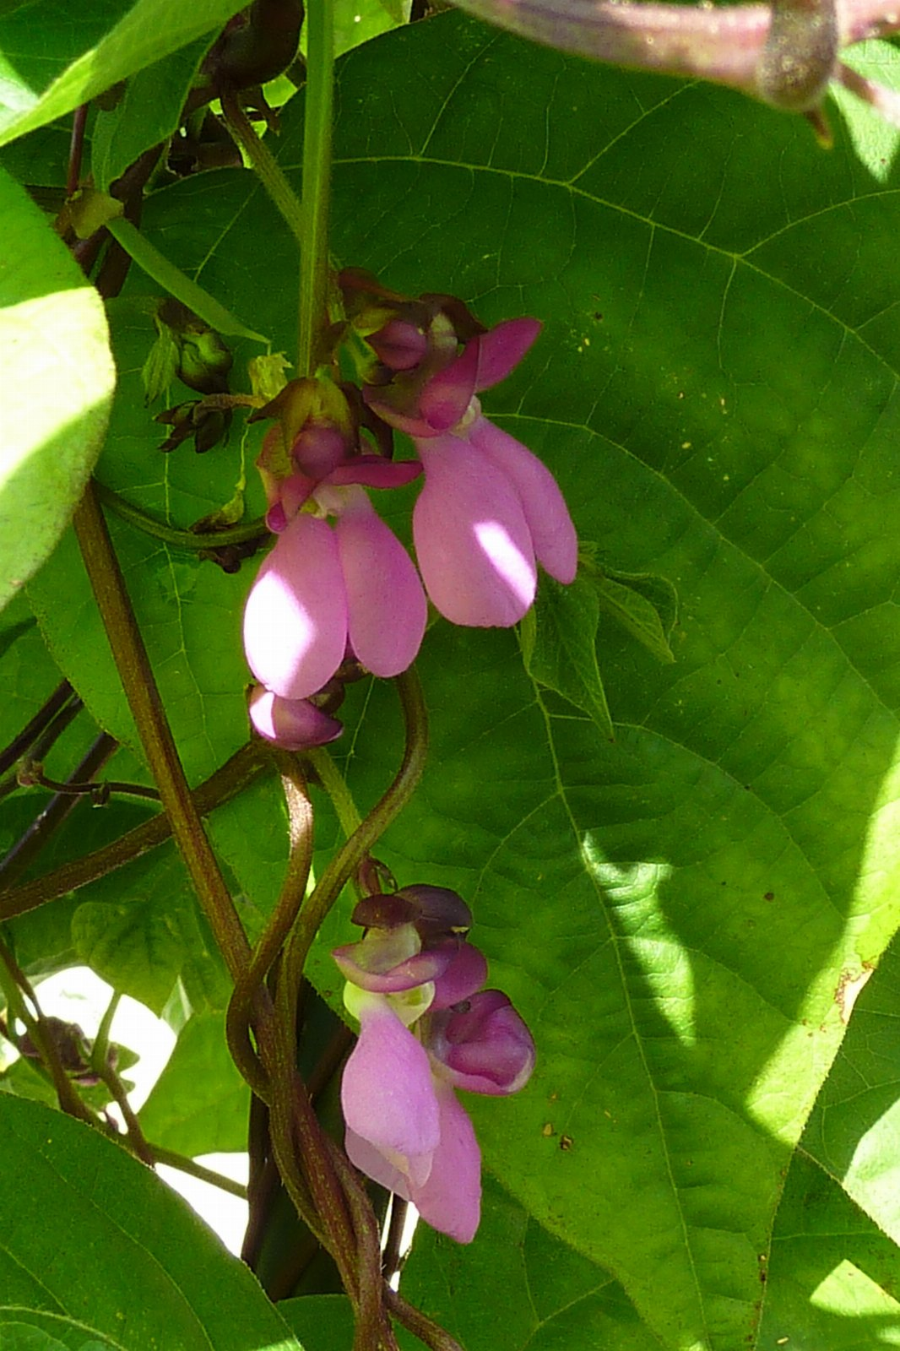
Rethinking beans
A WORKING DOCUMENT

Slide 2
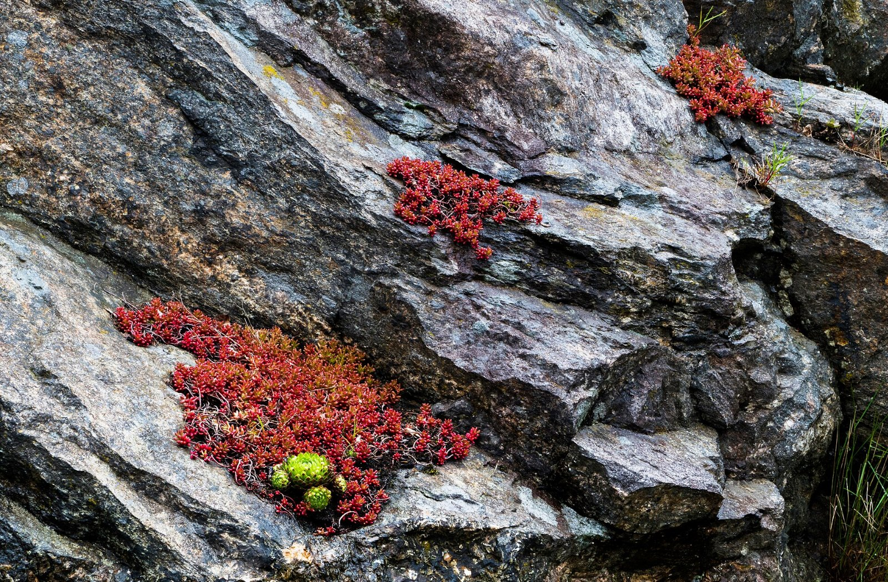
“Any of various leguminous plants grown for their edible seeds and pods.”
— Confucius

Slide 3
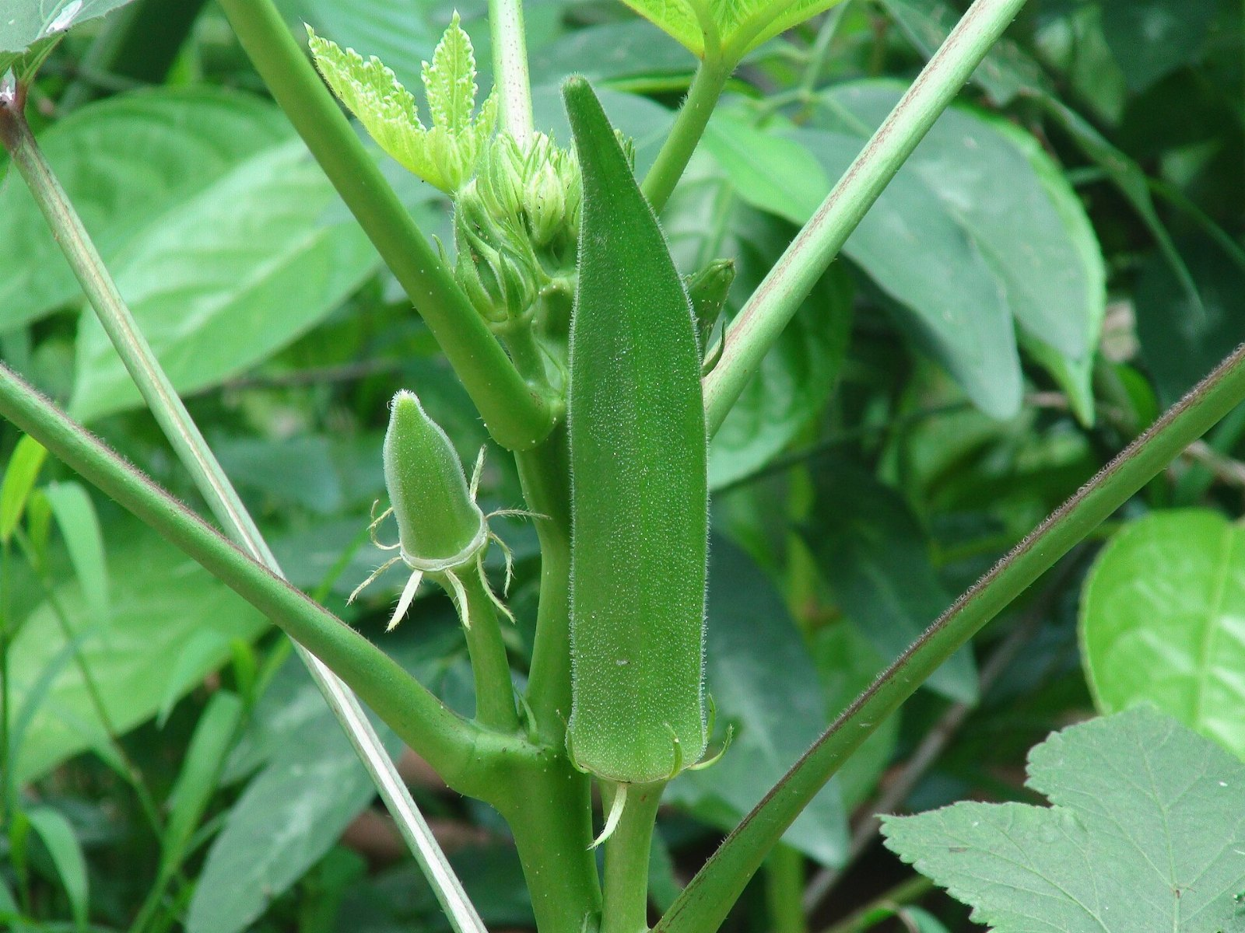
The okra gap
85
51
36
18
10
2021
2022
2023
2024
2025

Slide 4
ONE FIGURE
766,000
Before anyone noticed

Slide 5
Where we go from here

