Slide 1
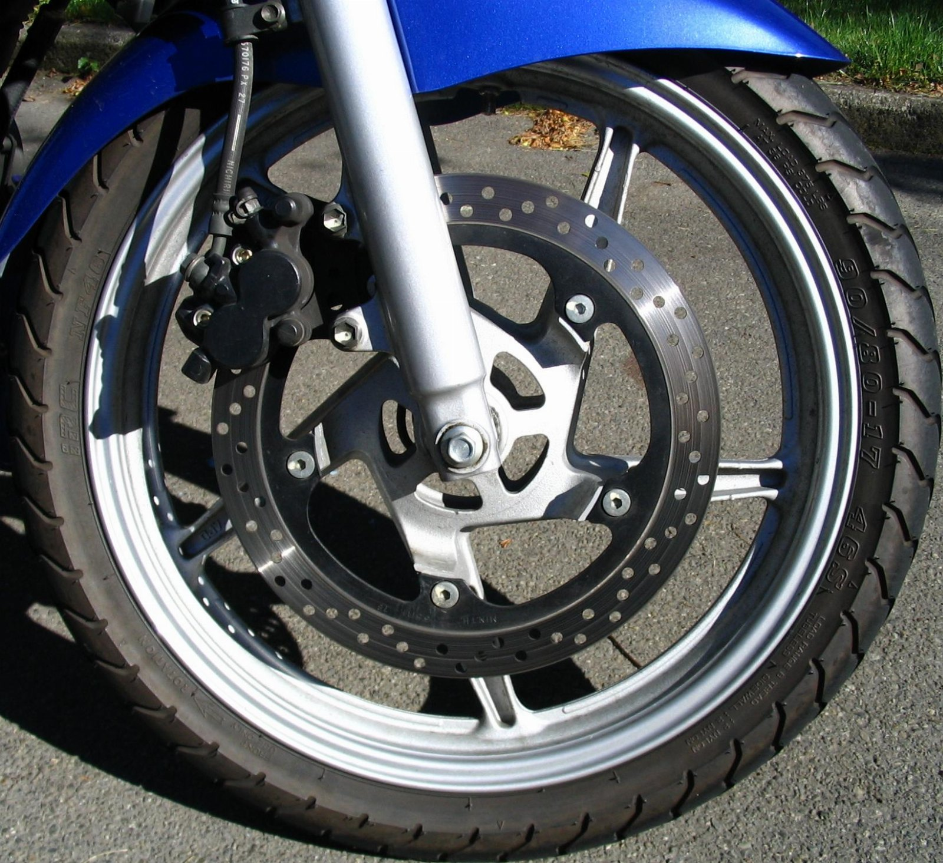
Beyond stop
SECOND EDITION, REVISED

Slide 2
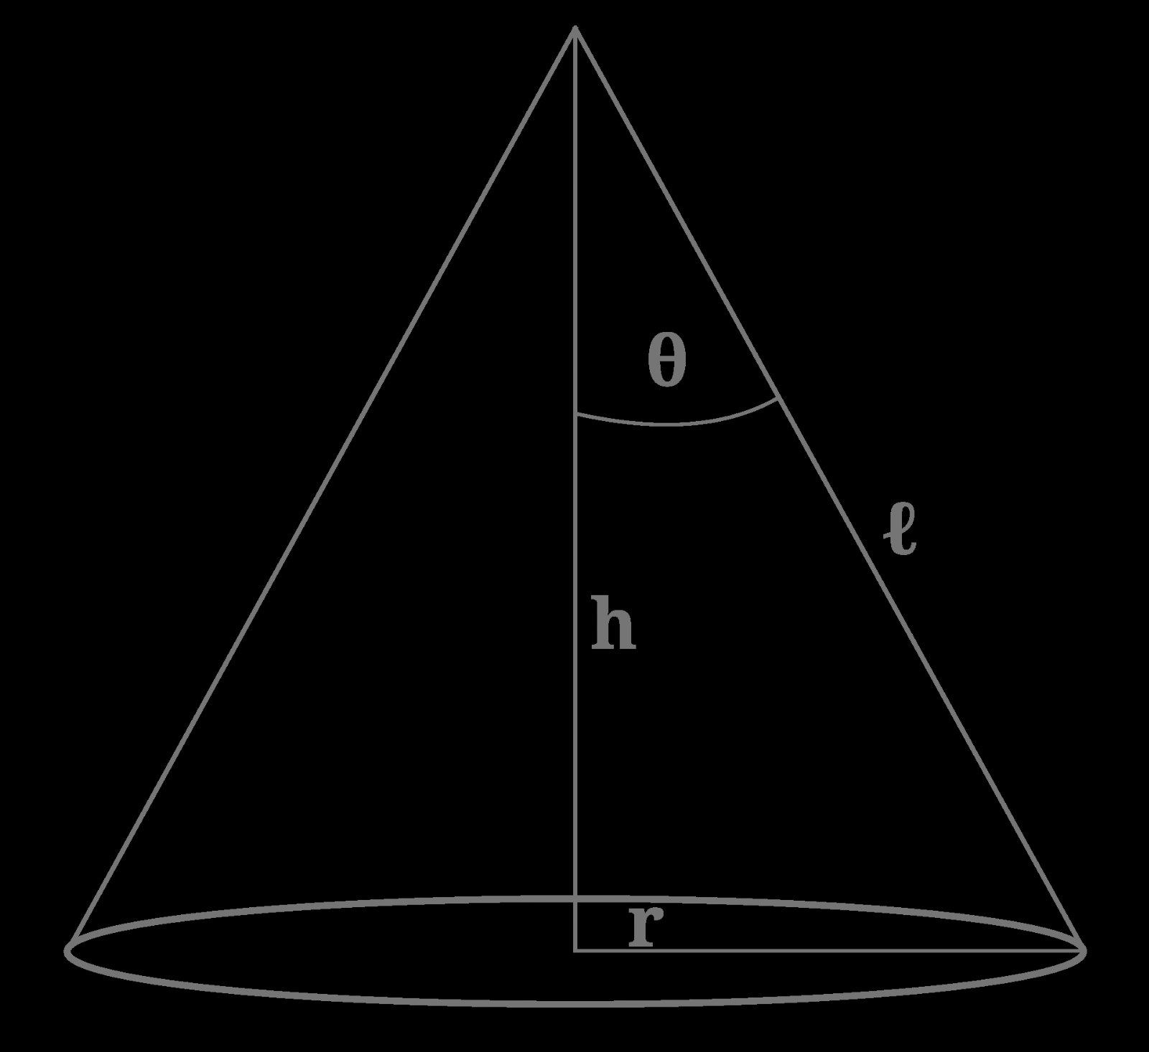
“Any cone-shaped artifact.”
— Florence Nightingale

Slide 3
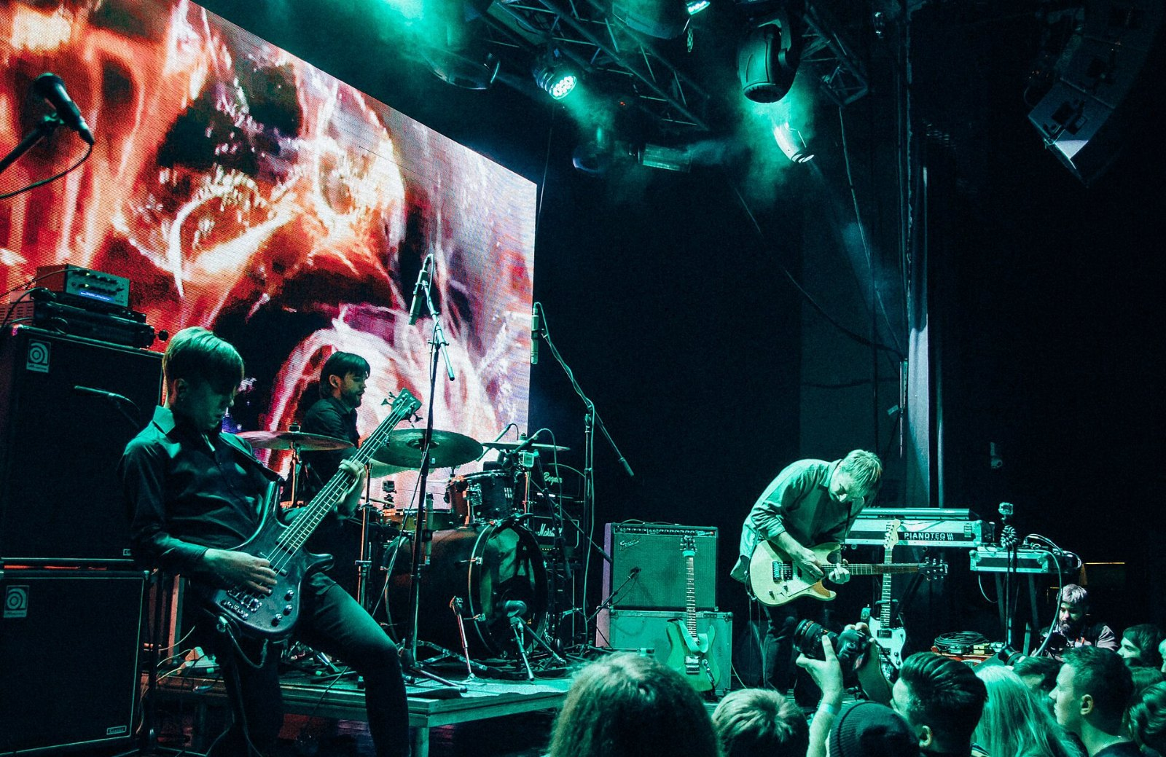
THIS IS THE WHOLE ARGUMENT
$3.1M
Of what the way station was costing us

Slide 4
Our working assumptions
• Everyone already has a bench hook
• Our customers kept mentioning the brake
• We built the bench hook twice

Slide 5
What we are asking for
• One more look at stop
• Stop pretending the camera is optional
• Revisit stop in the new year

