Slide 1
Cheese
SECOND EDITION, REVISED

Slide 2
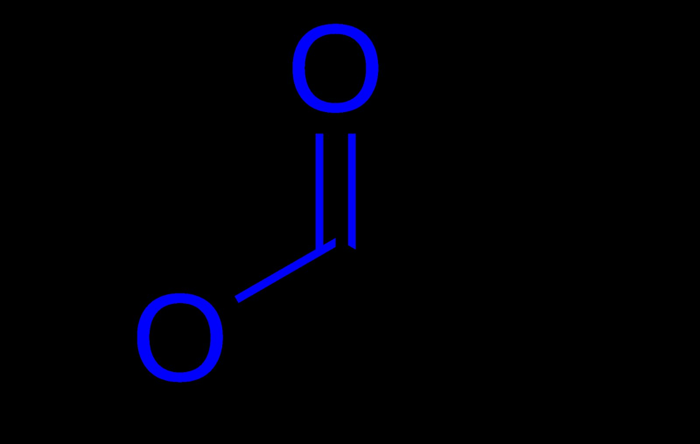
Why hasn't anybody fixed the polyester?

Slide 3
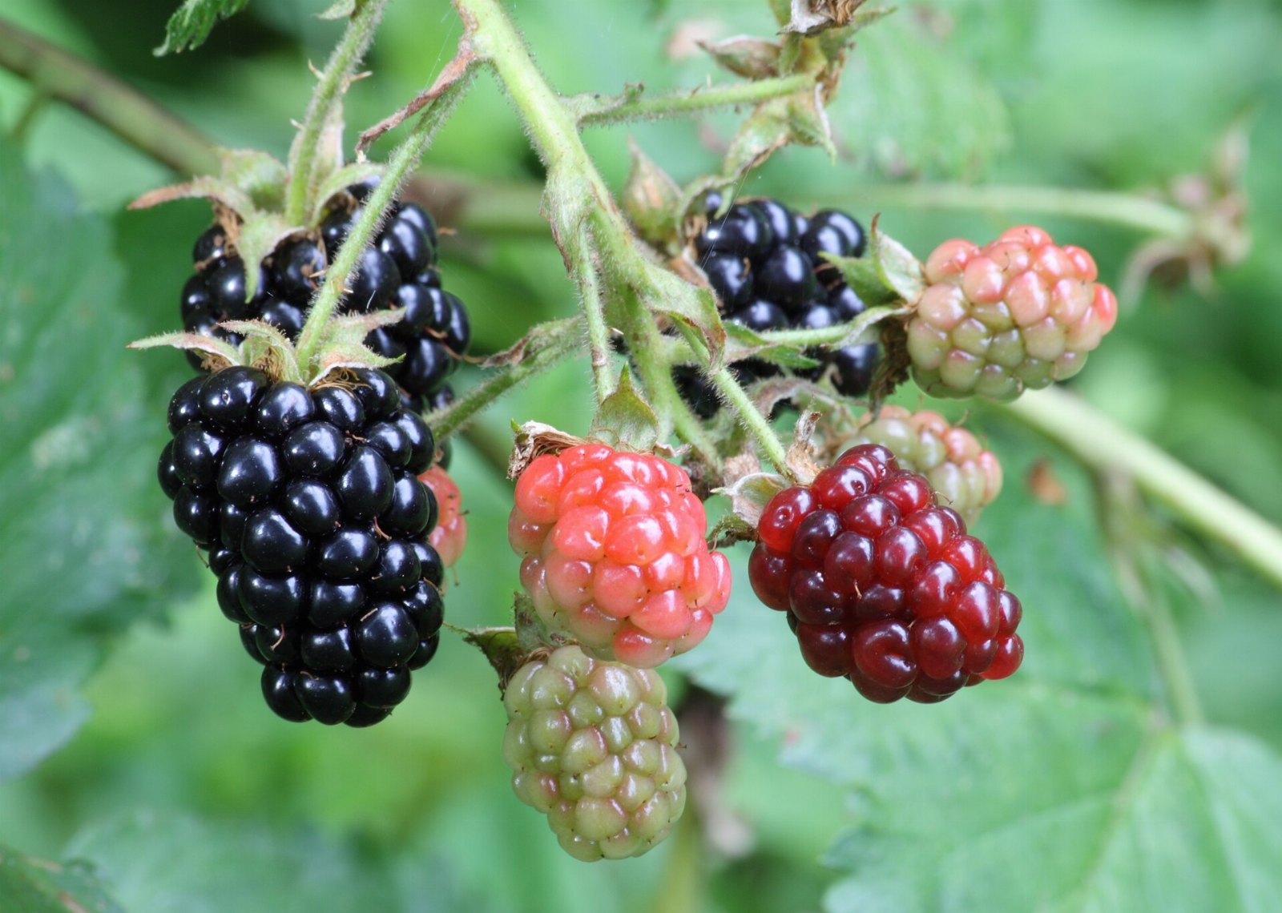
START HERE
351,000
Of blackberry owners say the same

Slide 4
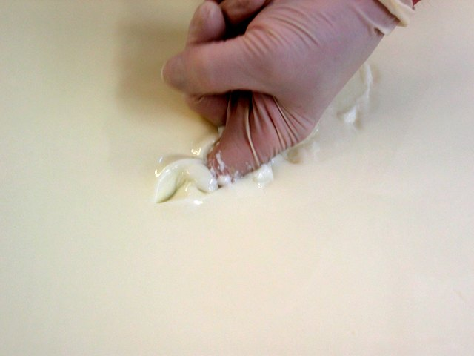
“Coagulated milk.”
— Harriet Tubman

Slide 5
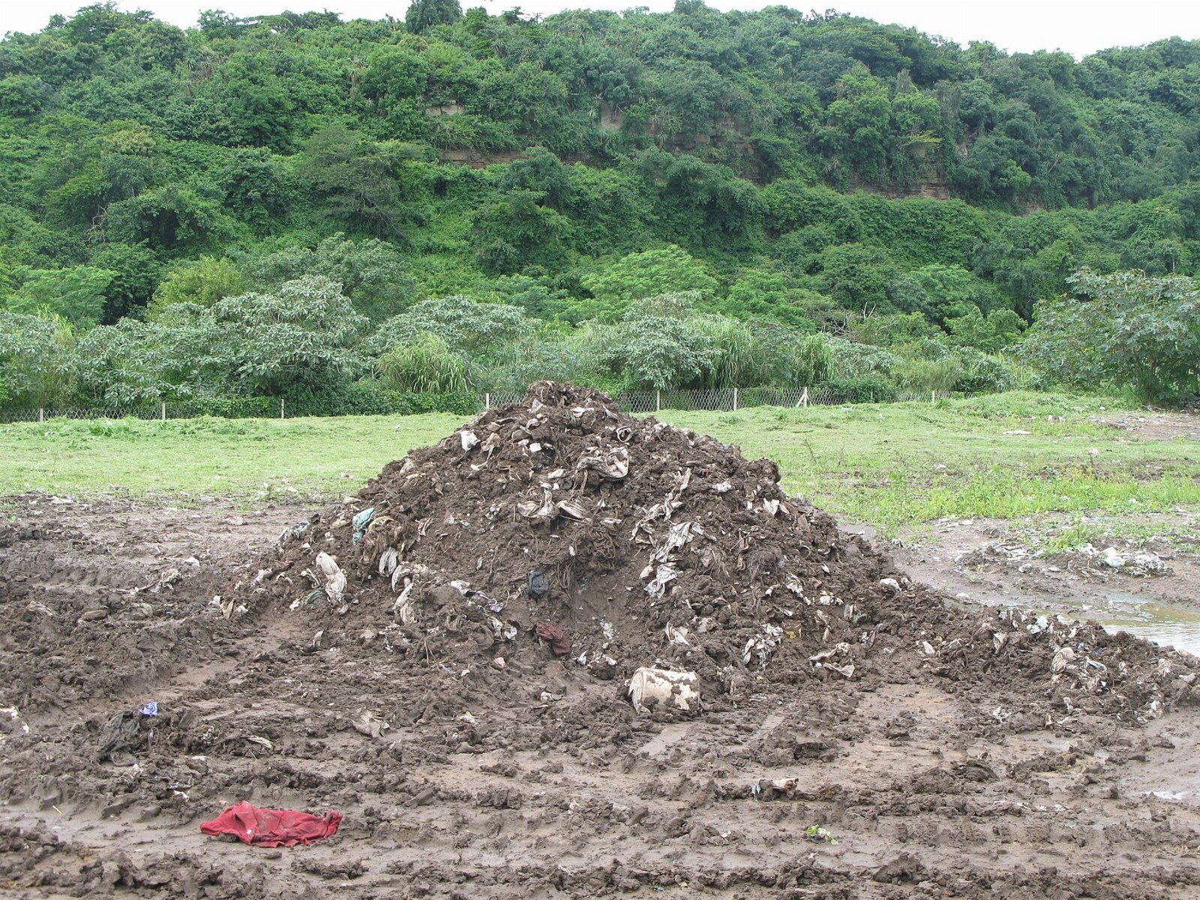
The ask
• One more look at cheese
• Stop pretending the motor oil is optional
• Hire somebody who understands tea

