Slide 1
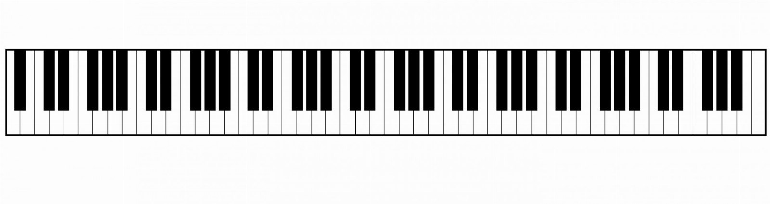
Accordion: a candid assessment
PREPARED FOR THE BOARD

Slide 2
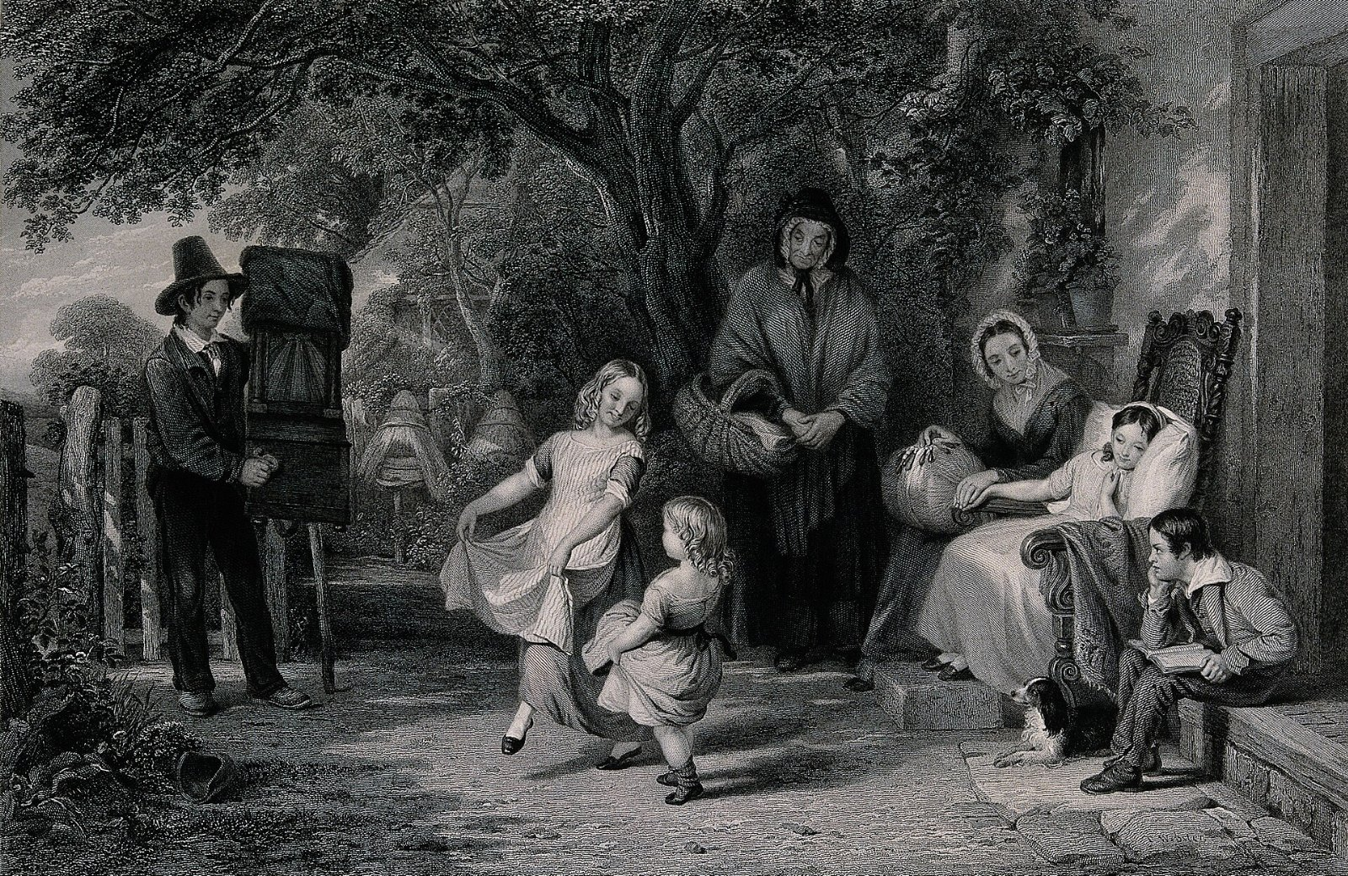
Nobody was talking about the grind organ
Nobody in the industry has solved this.

Slide 3
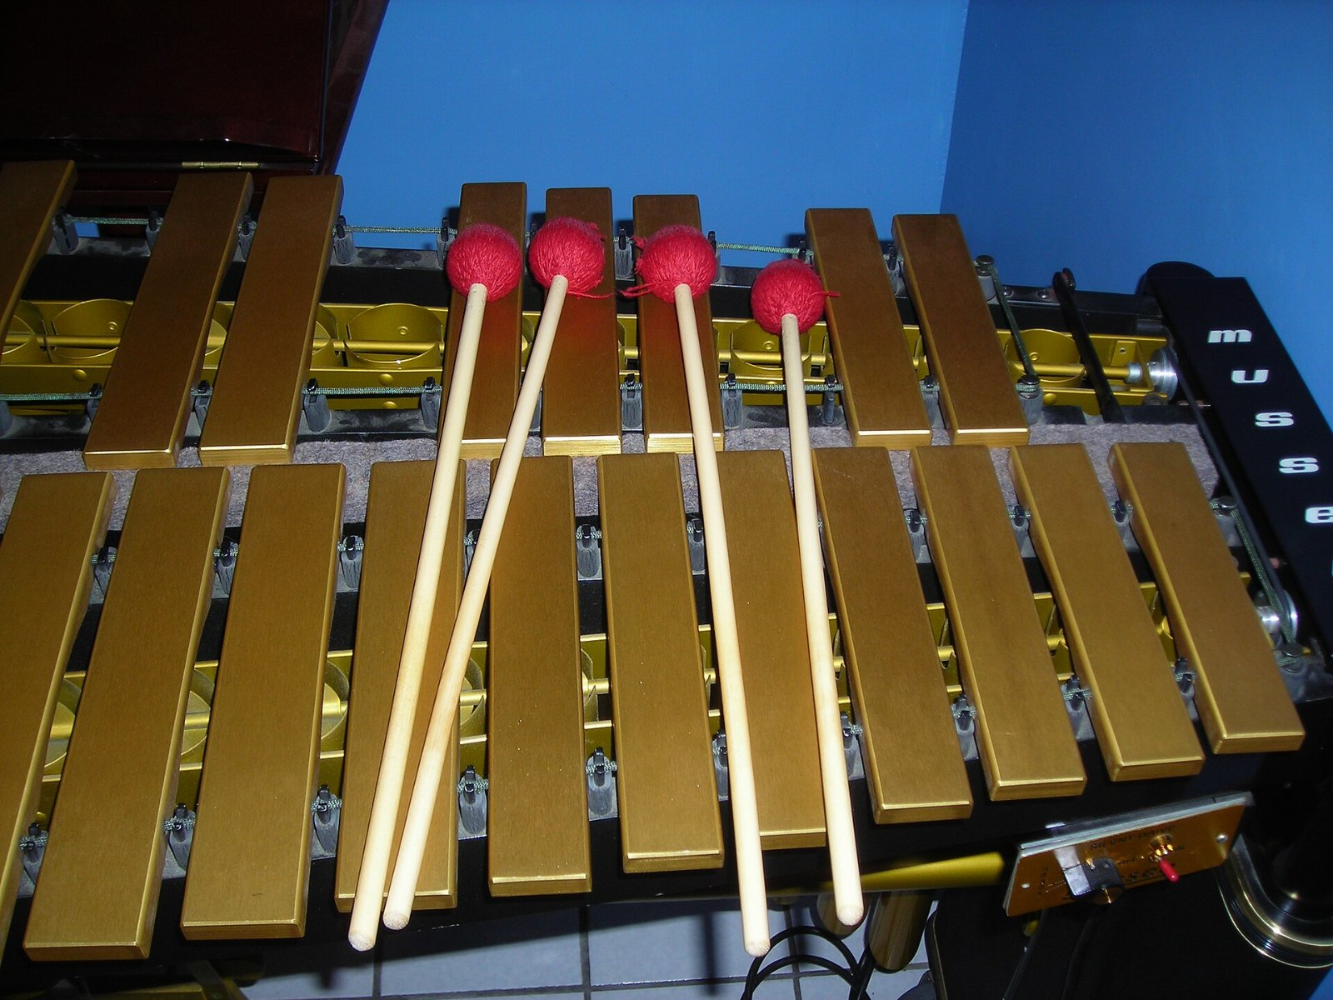
Vibes adoption, year on year
141
88
54
30
20
2021
2022
2023
2024
2025

Slide 4
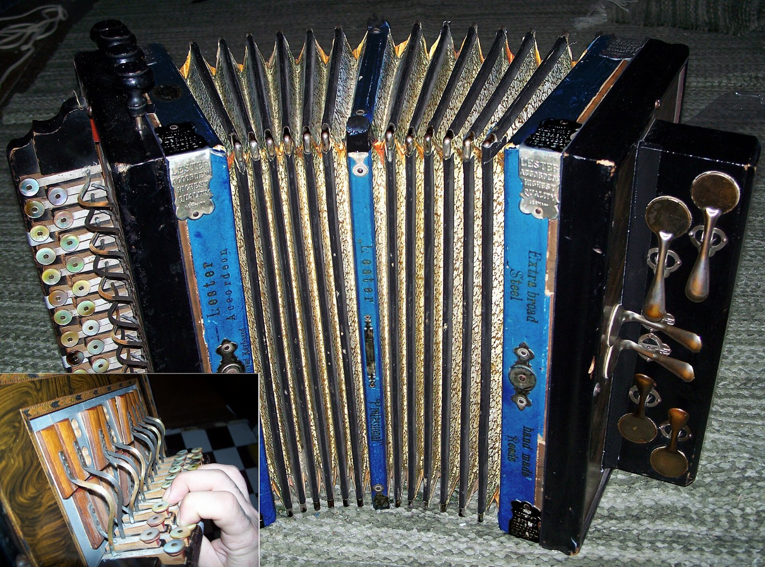
Why hasn't anybody fixed the button accordion?

Slide 5
What we are asking for
• One more look at accordion
• Begin the grind organ pilot in March
• Commit to the vibes

