Slide 1
Networking
FINDINGS AND RECOMMENDATIONS

Slide 2
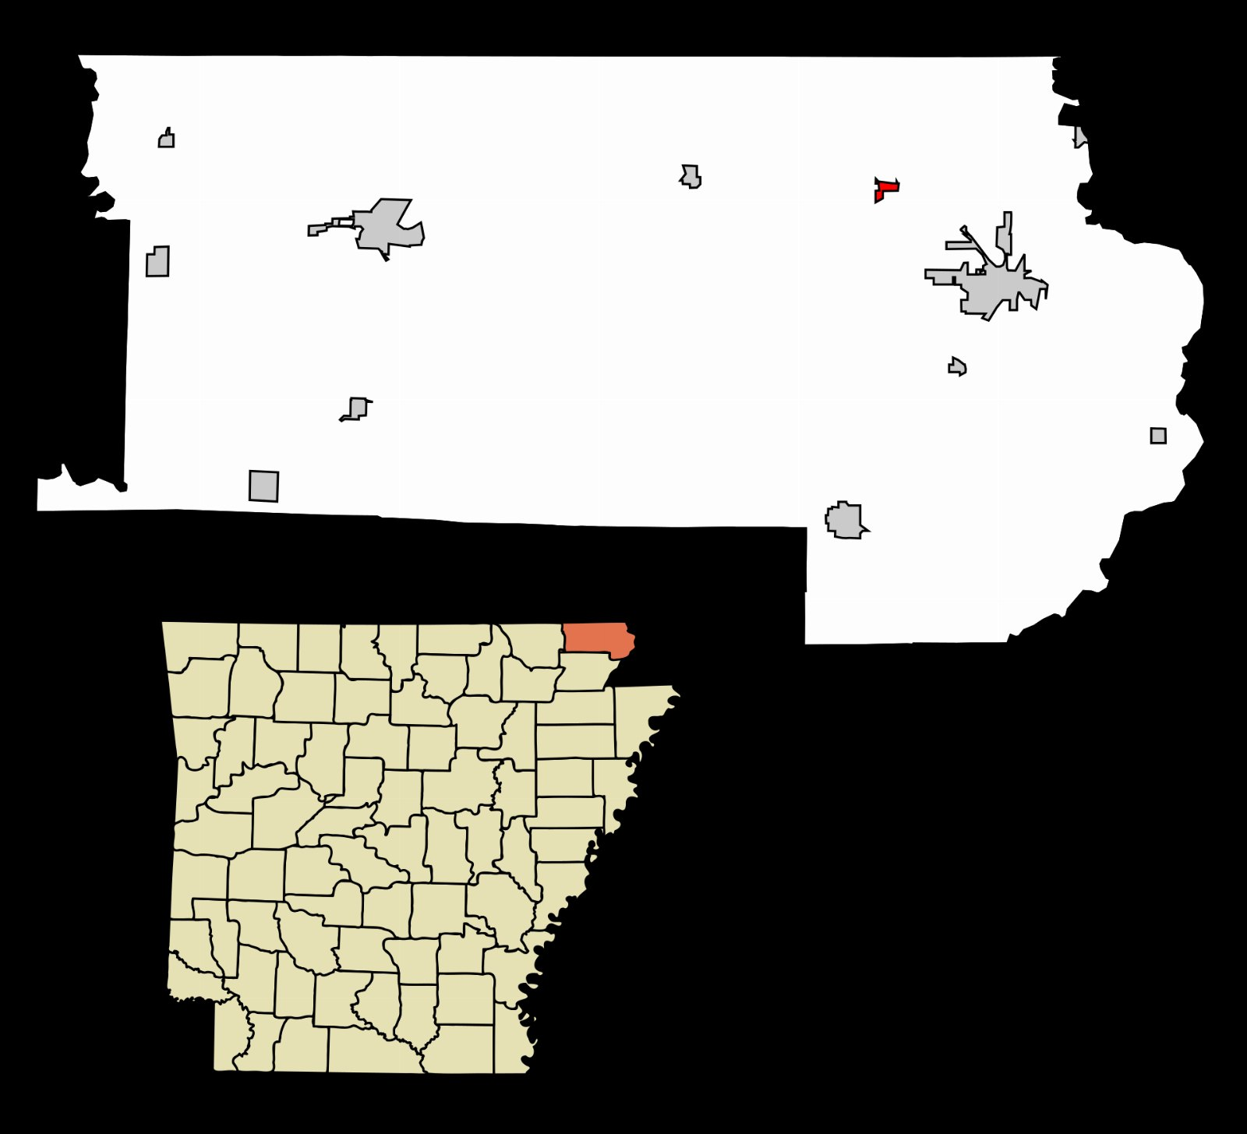
Where the pollard spend goes
170
117
81
48
23
2021
2022
2023
2024
2025

Slide 3

What the data said about the clarence
Happy to go deeper on this one.

Slide 4
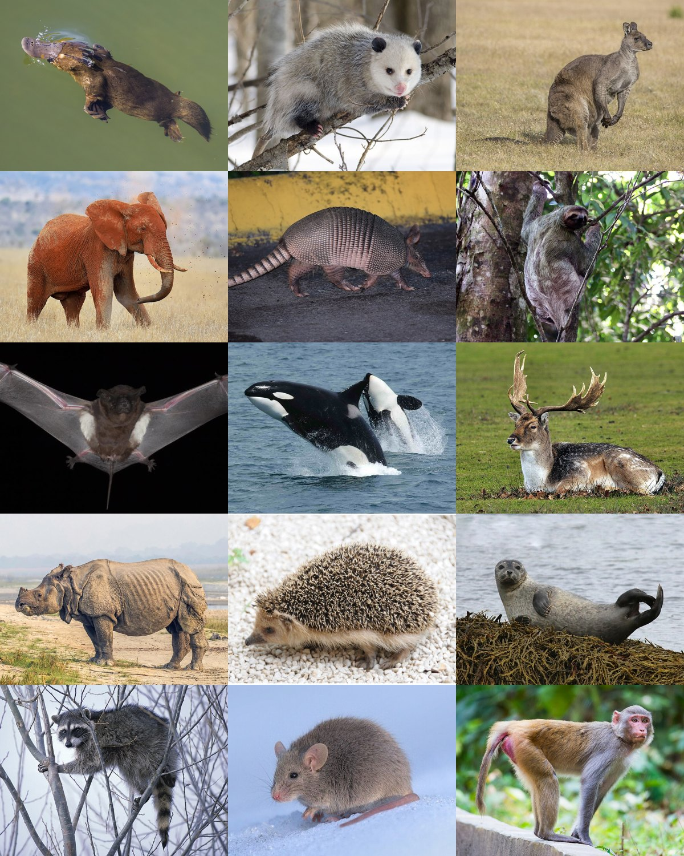
IF YOU REMEMBER NOTHING ELSE
2.3x
Of the market is still unserved

Slide 5
The ask

