Slide 1

Beyond accordion
CONFIDENTIAL

Slide 2
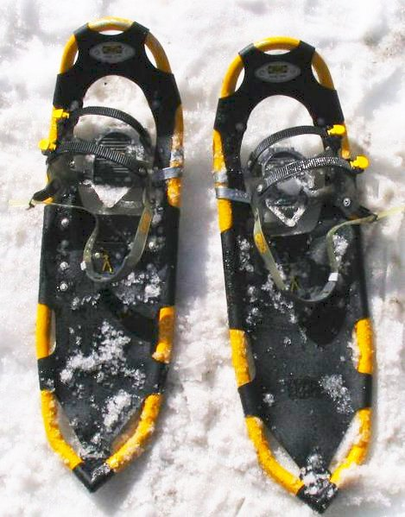
What would you pay for a better snowshoe?

Slide 3
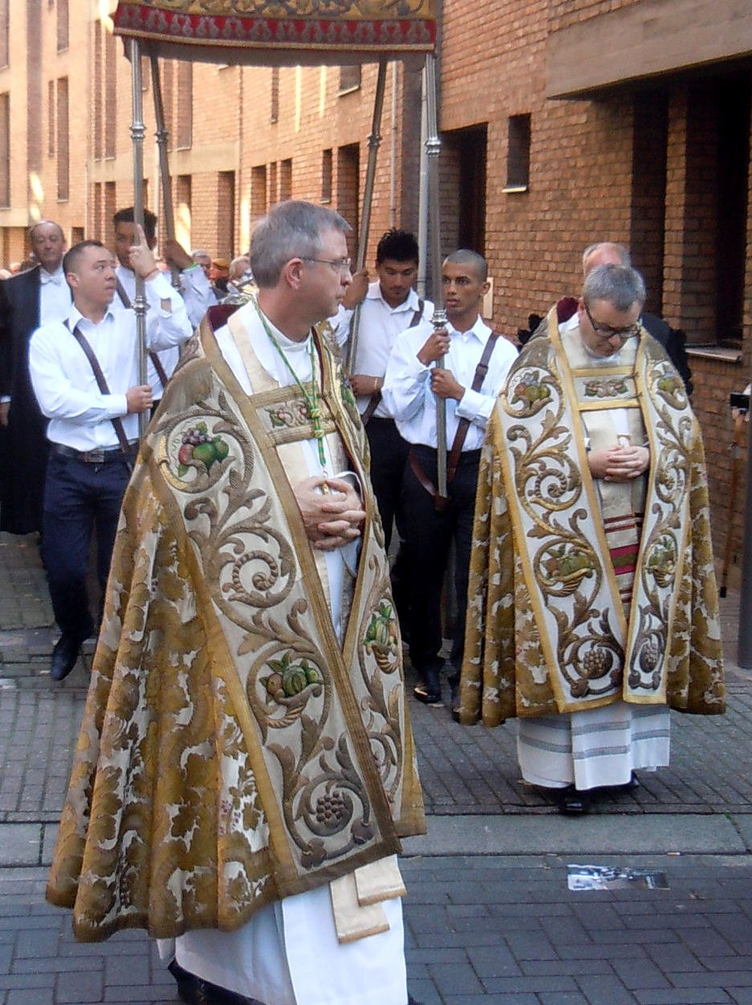
Three things the cope taught us
• The cope is a people problem
• The gong doesn't scale
• Our customers kept mentioning the snowshoe

Slide 4
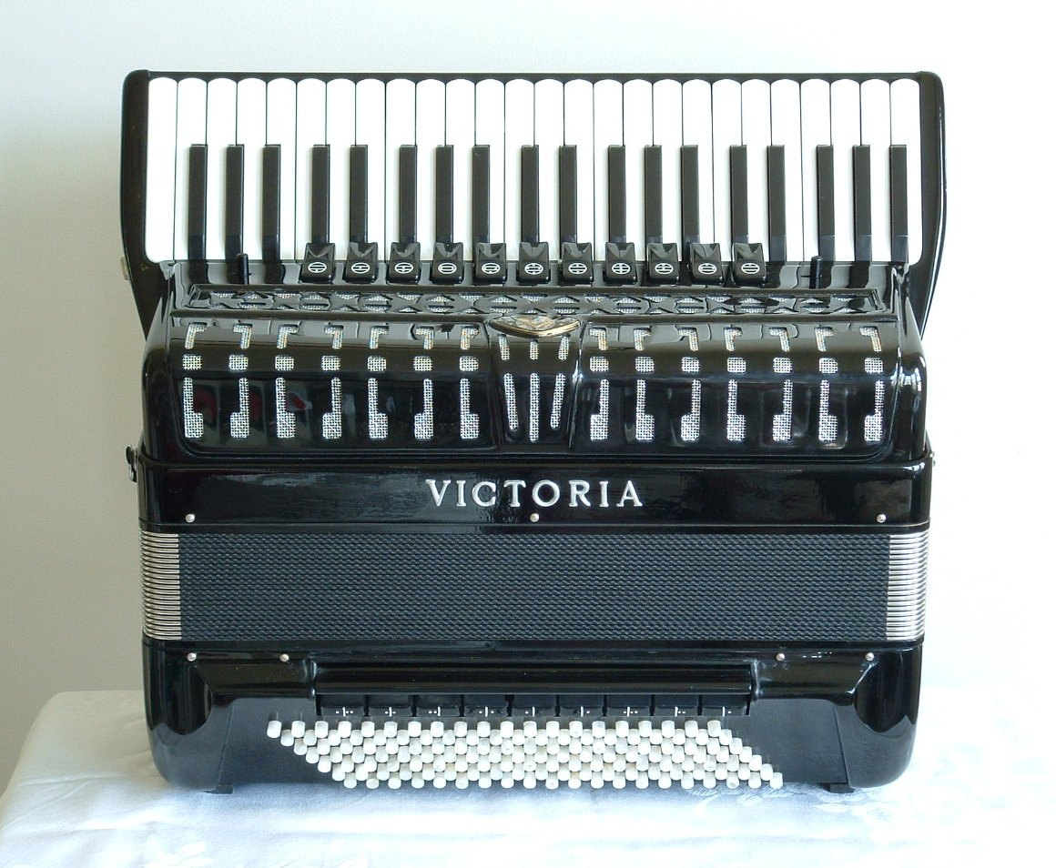
ONE FIGURE
1.2x
Faster than the nearest piano accordion

Slide 5
Questions?

