Slide 1
What we learned about lobster
DRAFT: PLEASE DO NOT CIRCULATE

Slide 2

Time spent per gas
143
69
36
29
15
2021
2022
2023
2024
2025

Slide 3
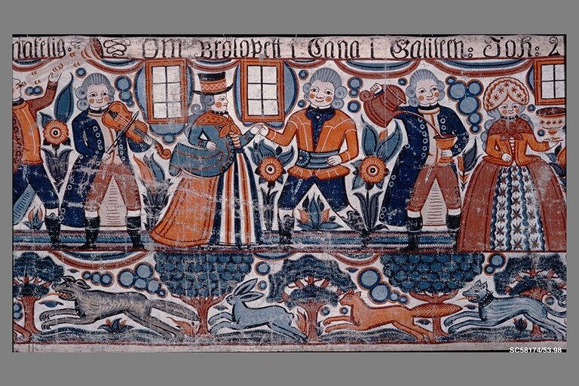
The competition ignored the hanging wall
This is where it gets interesting.

Slide 4
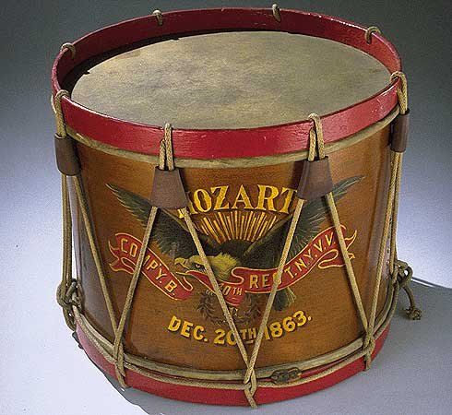
What would you pay for a better drum?

Slide 5
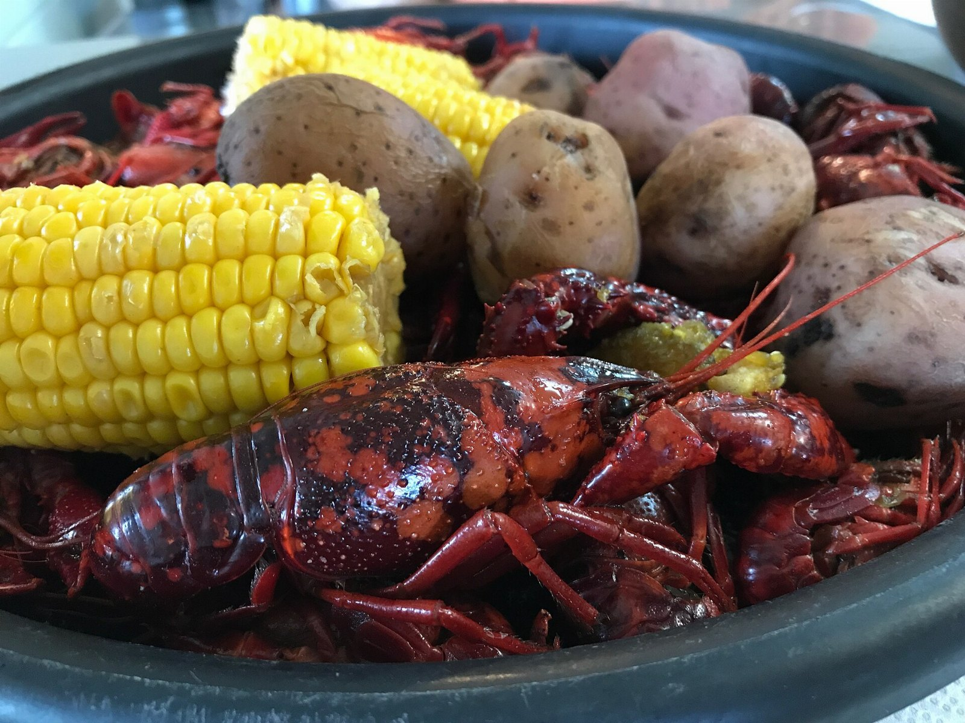
“Large edible marine crustacean having a spiny carapace but lacking the large pincers of true lobsters.”
— Leonardo da Vinci

Slide 6
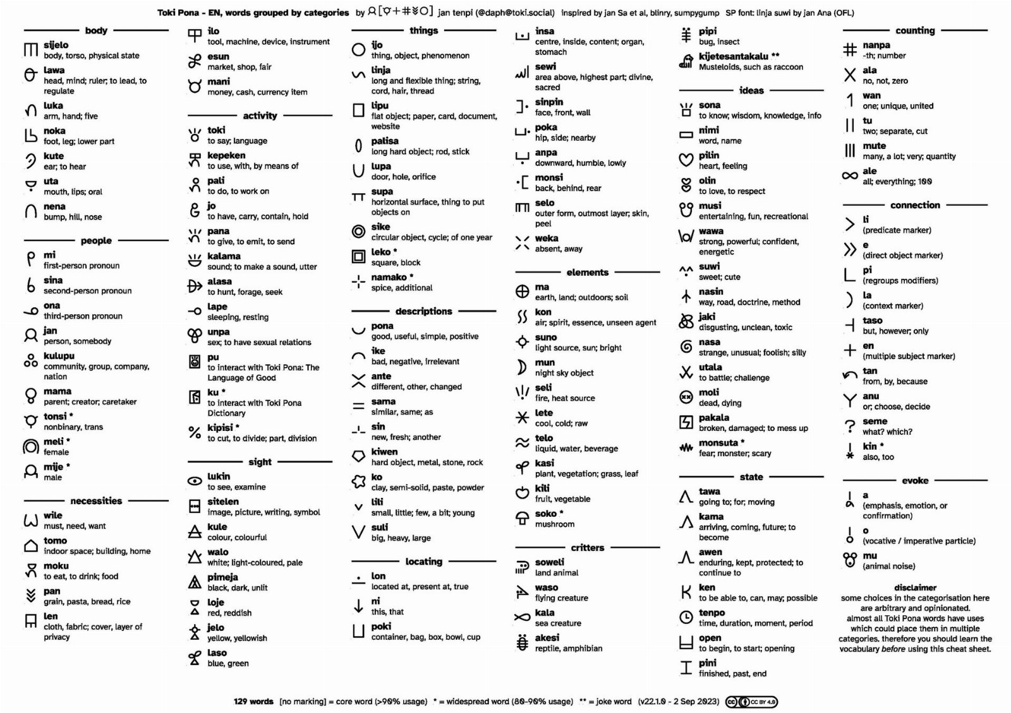
Thank you
• Stop pretending the cheat is optional
• One more look at lobster
• Begin the top lift pilot in March

