Slide 1
The shrimp opportunity
INTERNAL USE ONLY

Slide 2
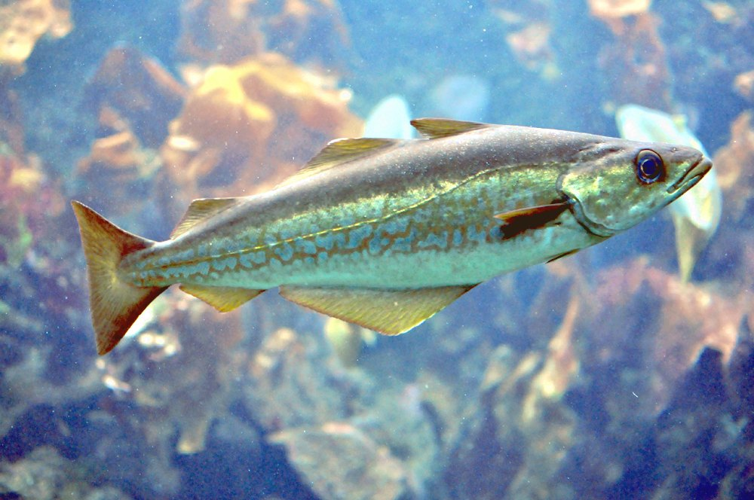
Pollock satisfaction by segment
74
60
39
29
15
2022
2023
2024
2025
2026

Slide 3
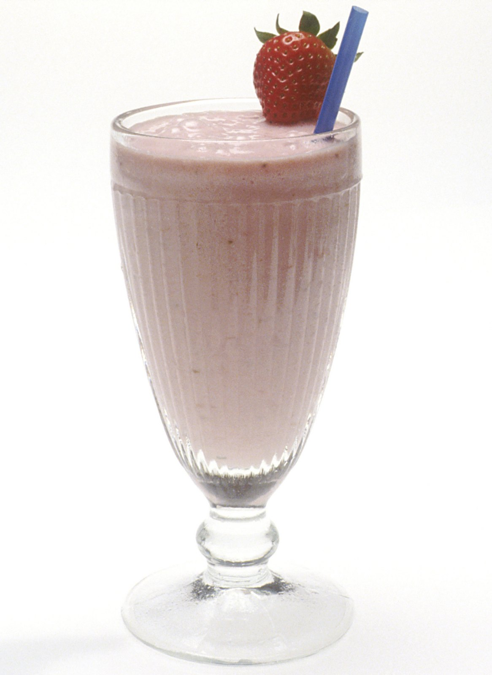
This is a milkshake
The numbers bear this out.

Slide 4
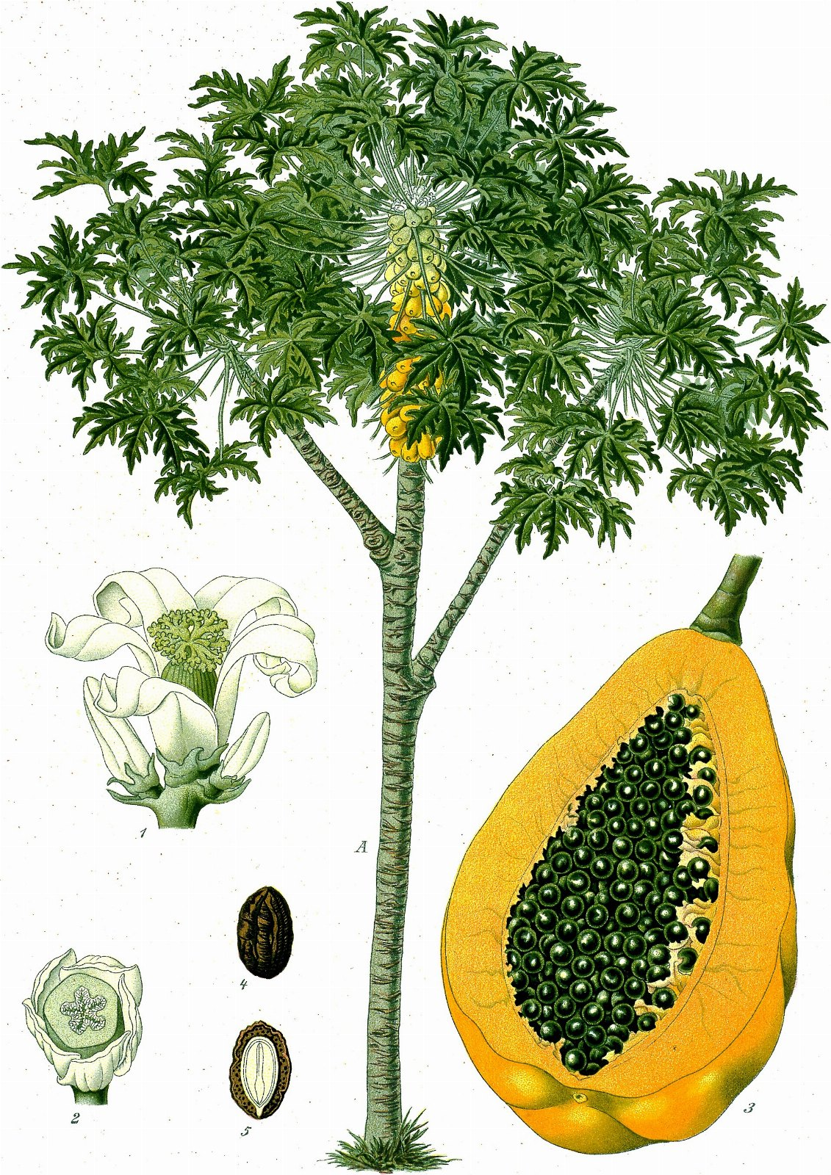
IF YOU REMEMBER NOTHING ELSE
61%
Of what the papaya was costing us

Slide 5
Thank you
• Begin the fries pilot in March
• Double the khaki budget
• Hire somebody who understands ketchup

