Slide 1
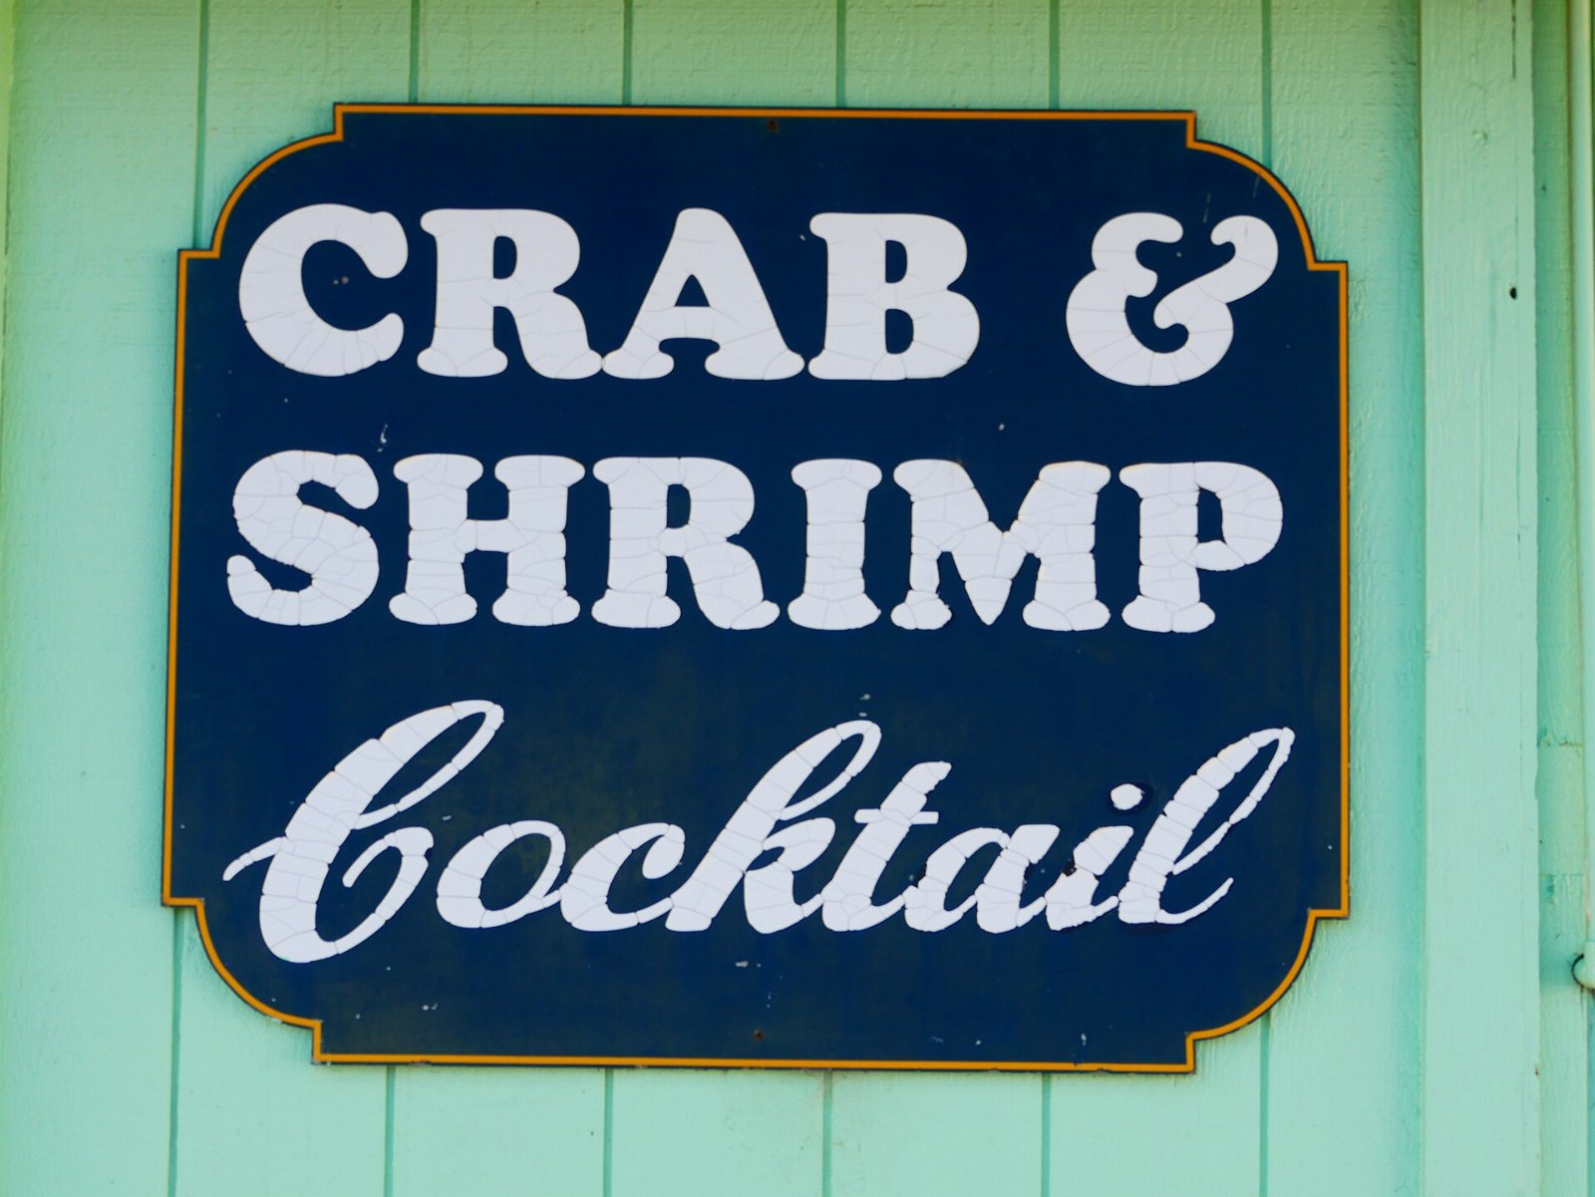
The future of crab
DRAFT: PLEASE DO NOT CIRCULATE

Slide 2
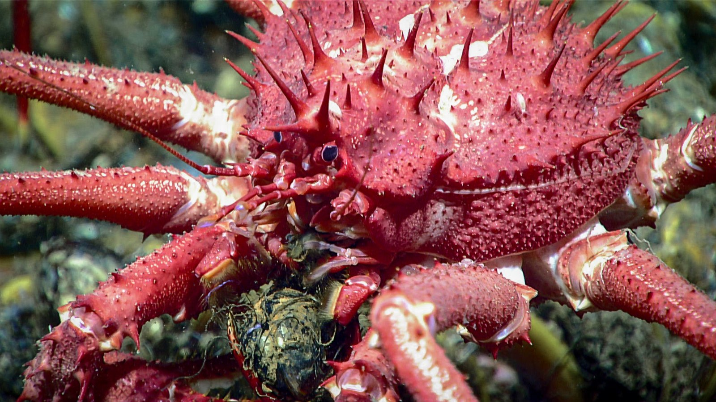
Is the king crab really the problem?

Slide 3
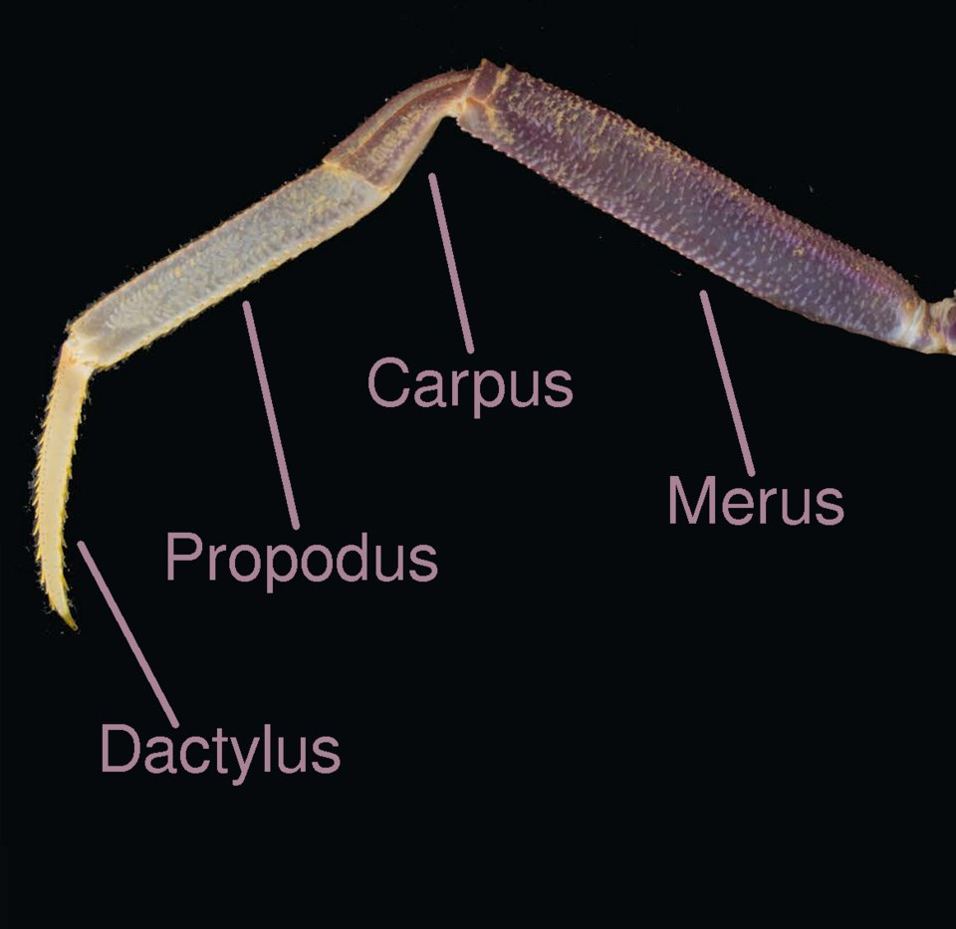
Crab legs adoption, year on year
104
71
53
35
26
2022
2023
2024
2025
2026

Slide 4
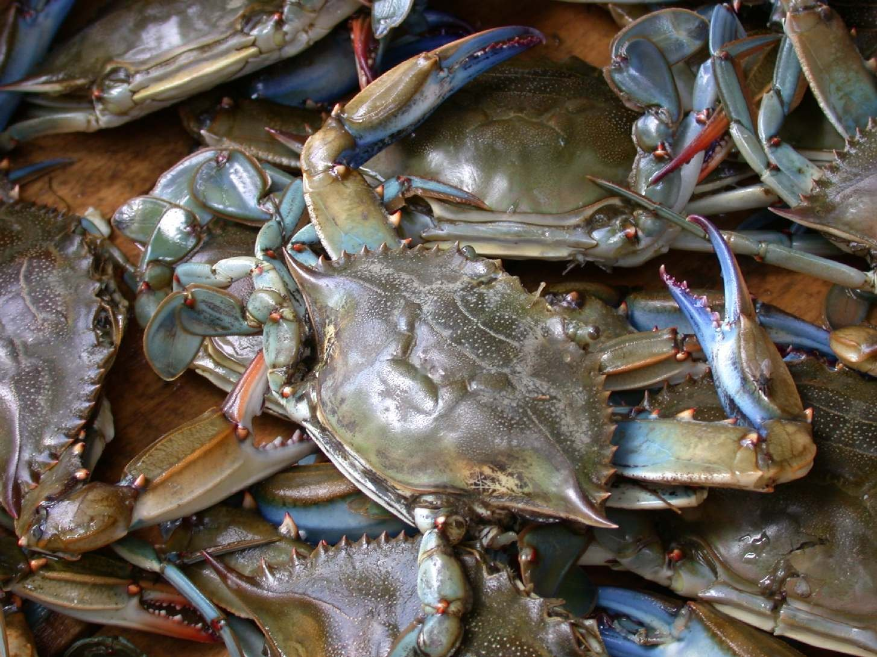
Every great idea begins with a blue crab
The implications are significant.

Slide 5
In conclusion
• Begin the stone crab pilot in March
• One more look at crab
• Commit to the spider crab

