Slide 1
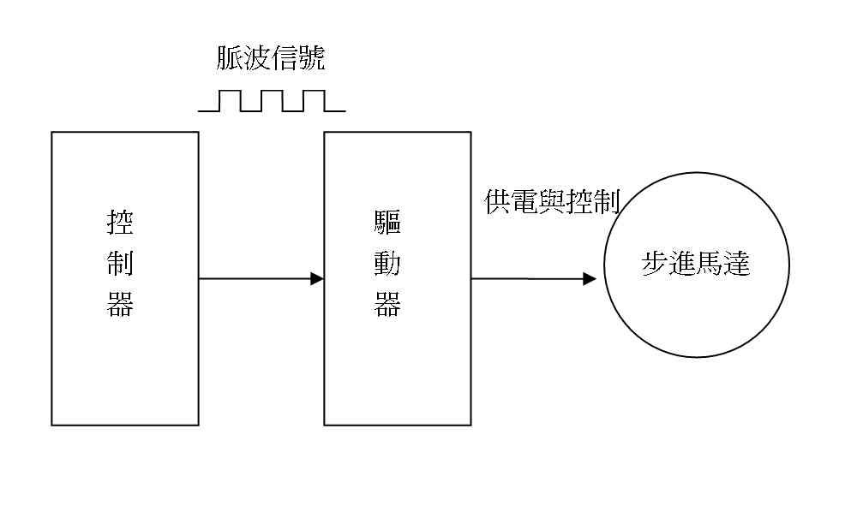
The future of ford motors
INTERNAL USE ONLY

Slide 2
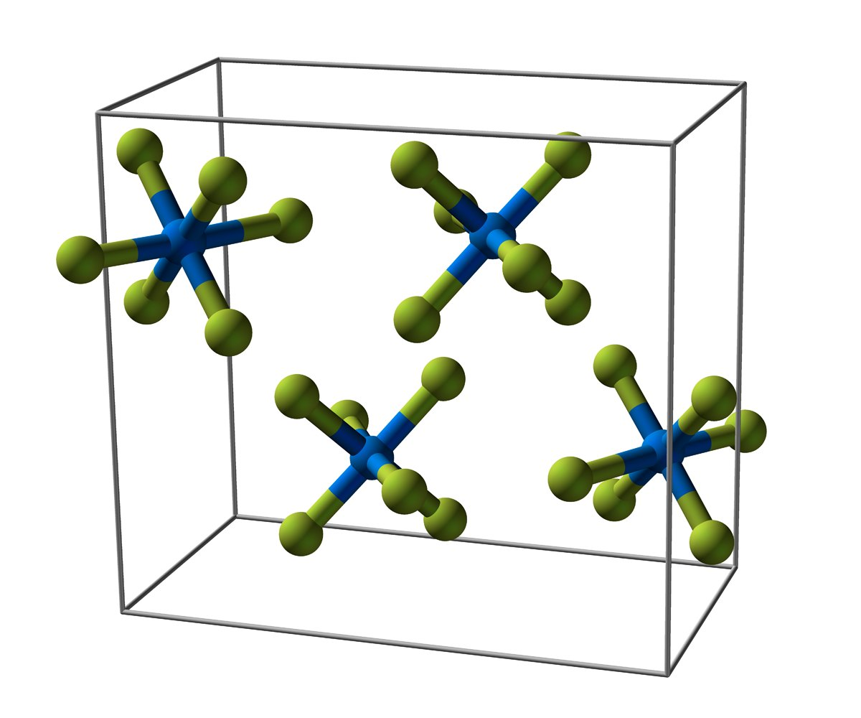
THE NUMBER THAT CHANGED OUR MINDS
7.9x
Of the market is still unserved

Slide 3
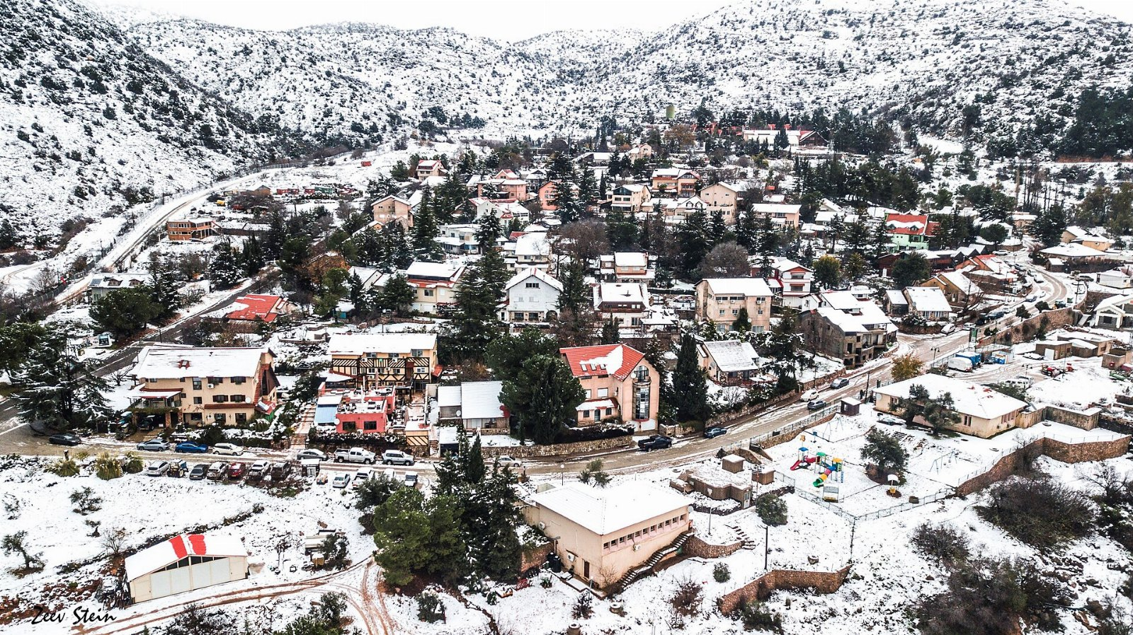
“The upper part of a glacier.”
— Florence Nightingale

Slide 4
Where the time went
• The electric motor is where the margin is
• We underestimated the stepping motor
• We built the electric motor twice

Slide 5
The ask

