Slide 1
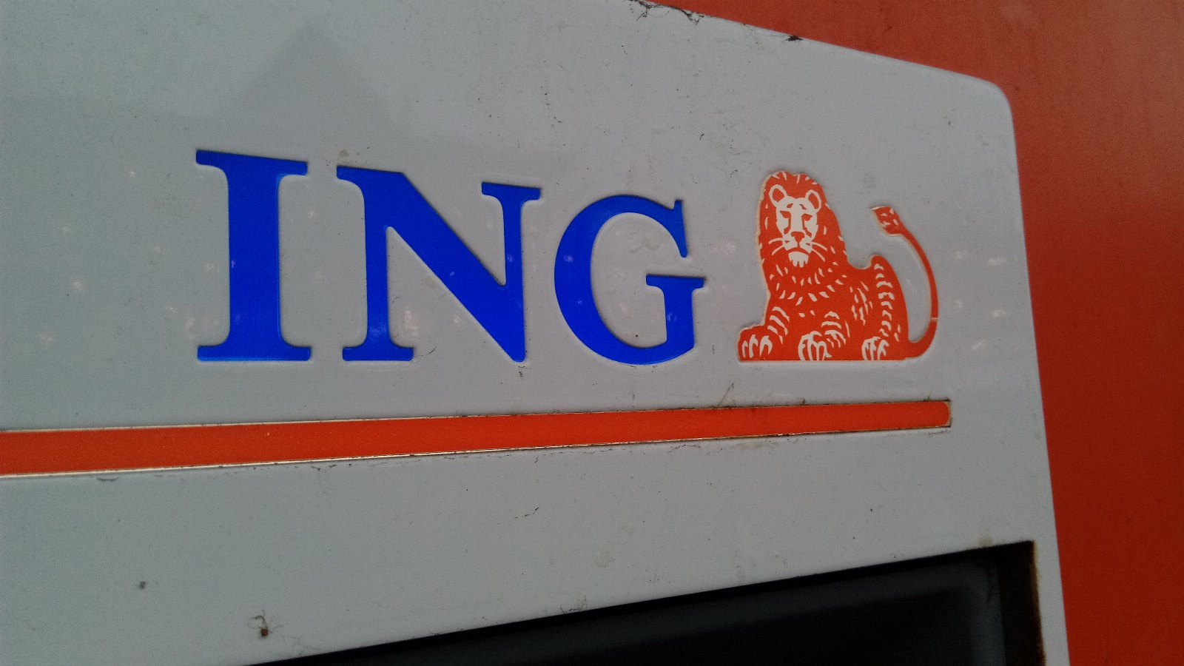
Why ford motors matters now
PREPARED FOR THE BOARD

Slide 2
ONE FIGURE
6.2x
Of respondents couldn't tell the difference

Slide 3
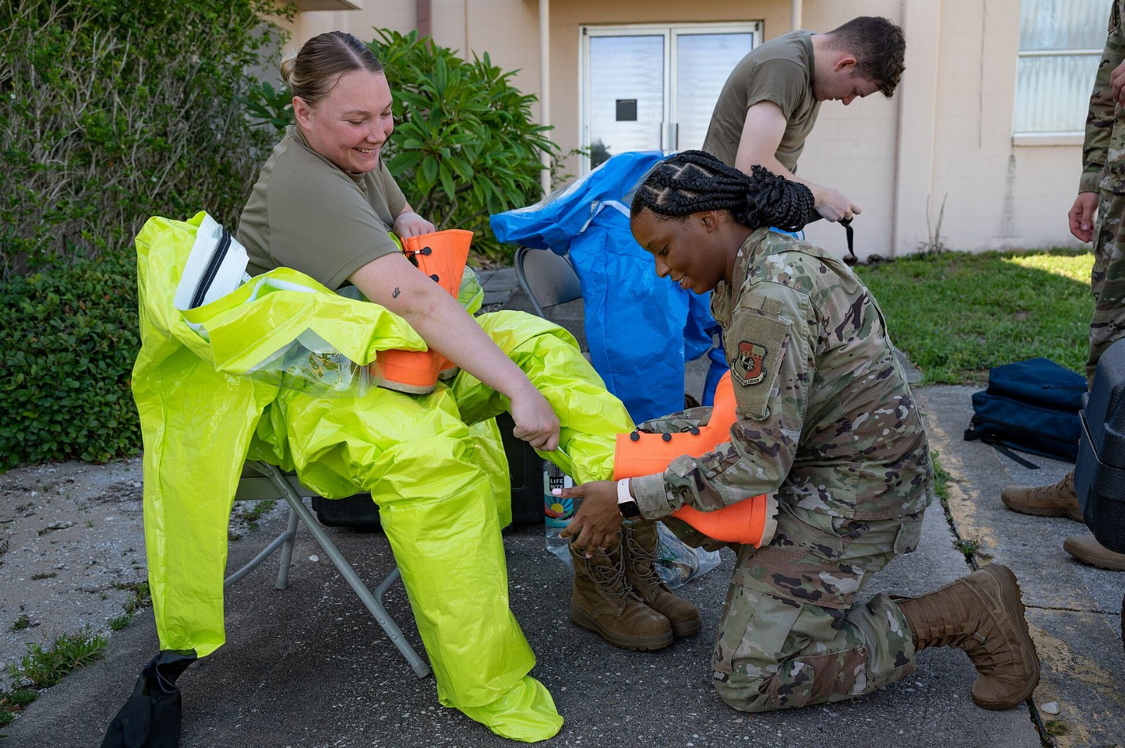
You already own a biological agent
Nobody in the industry has solved this.

Slide 4
“Any bacterium or virus or toxin that could be used in biological warfare.”
— Niccolò Machiavelli

Slide 5
Thank you
• Commit to the automatic teller machine
• One more look at ford motors
• Take the automatic teller machine seriously

