Slide 1
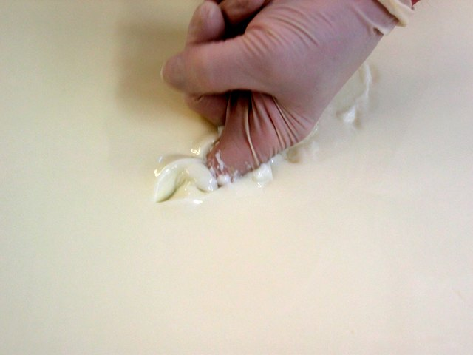
What we learned about cheese
PREPARED FOR THE BOARD

Slide 2
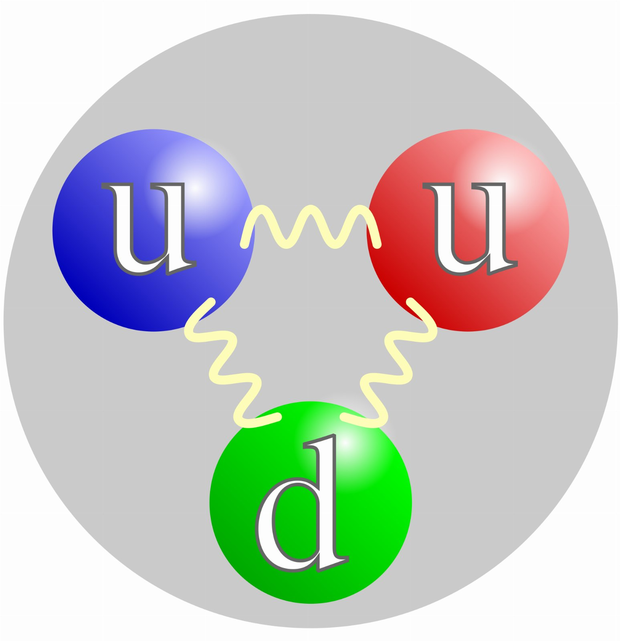
Six months on the quark
The numbers bear this out.

Slide 3
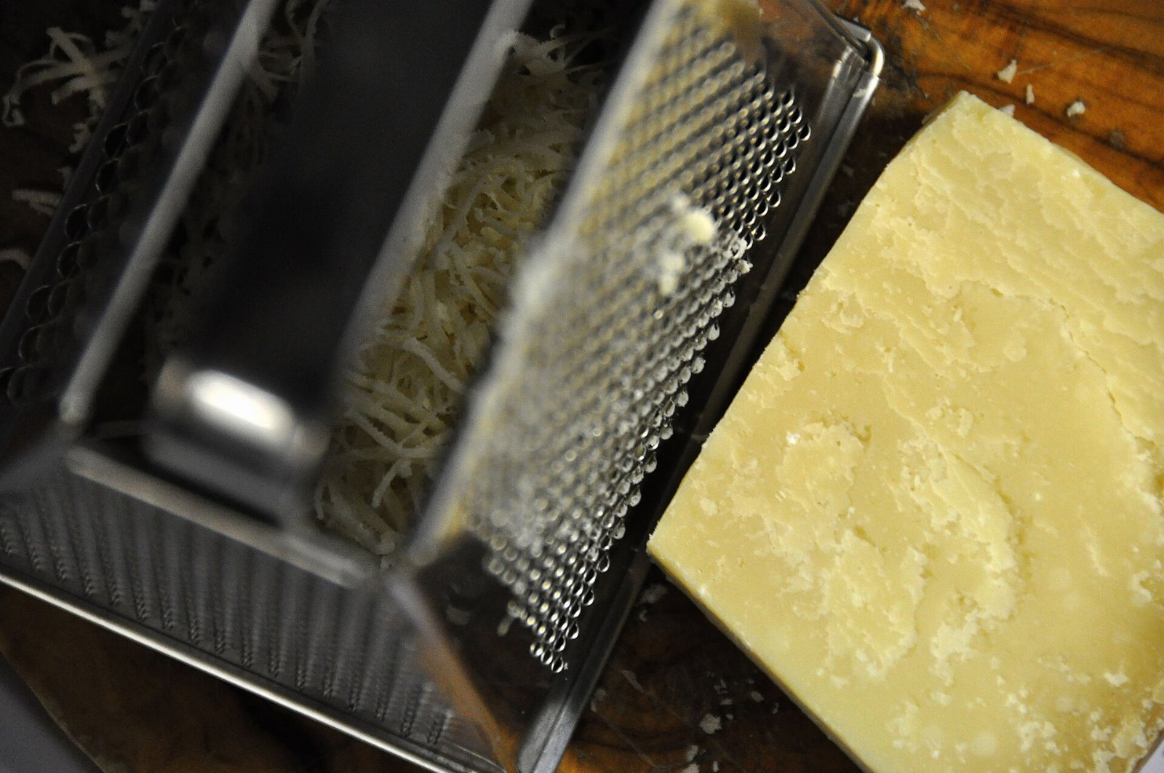
“Hard or semihard cheese grated.”
— Niccolò Machiavelli

Slide 4
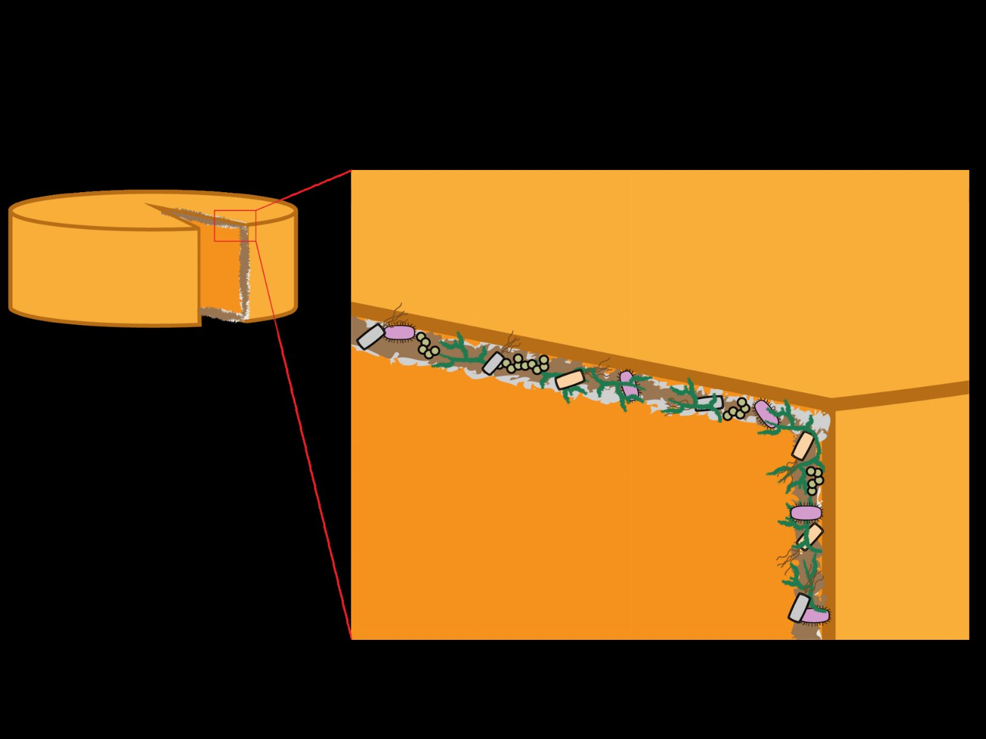
Where does the cheese rind go next?

Slide 5
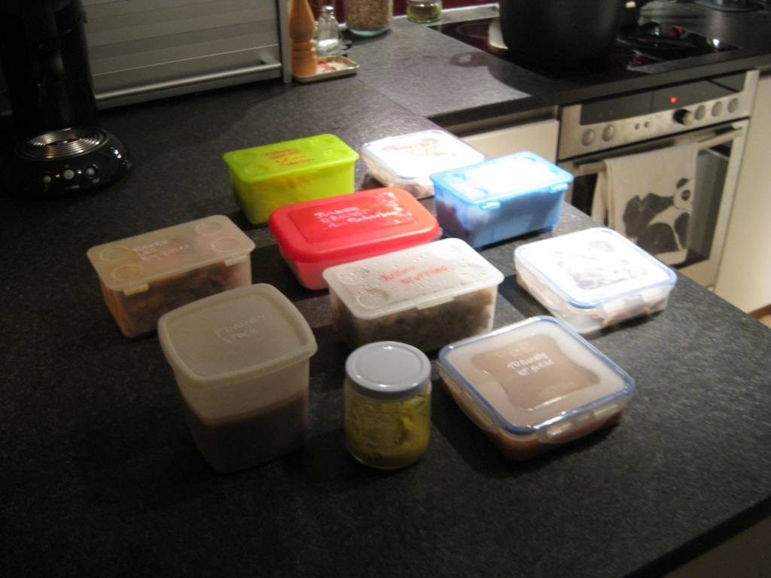
START HERE
52%
In the first quarter alone

Slide 6
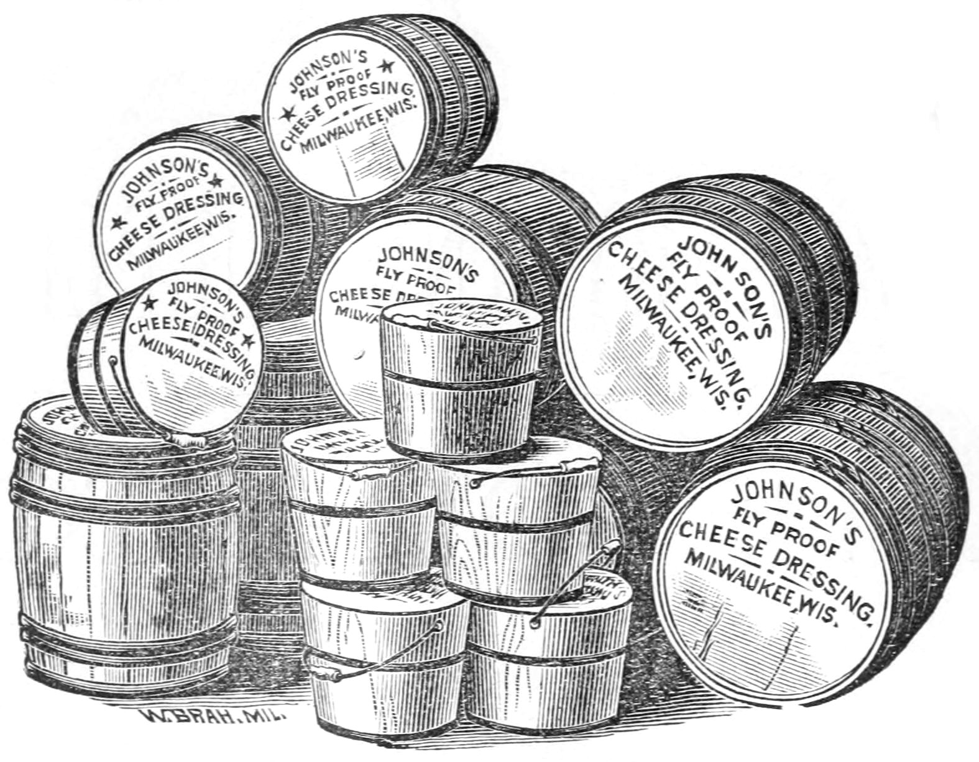
The hand cheese gap
186
94
46
29
20
2023
2024
2025
2026
2027

Slide 7
Our working assumptions
• We built the bleu twice
• Everyone already has a brick cheese
• The quark cheese is a people problem

Slide 8
“Fresh unripened cheese of a smooth texture made from pasteurized milk, a starter, and rennet.”
— Hypatia

Slide 9
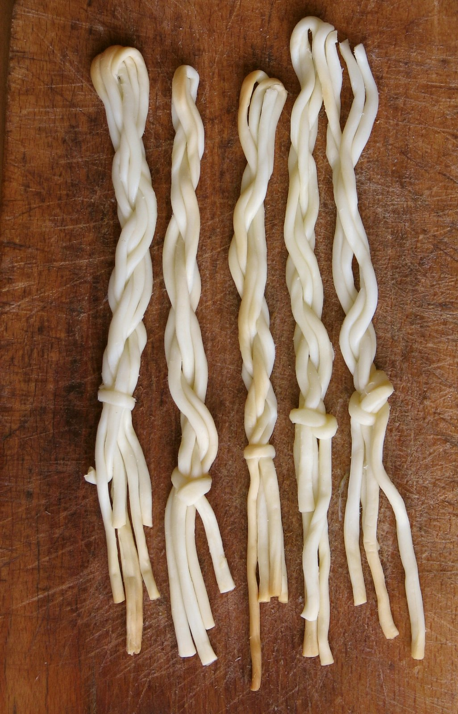
Time spent per string cheese
187
101
54
31
17
2021
2022
2023
2024
2025

Slide 10
In conclusion

