Slide 1
What we learned about lobster
FINDINGS AND RECOMMENDATIONS

Slide 2
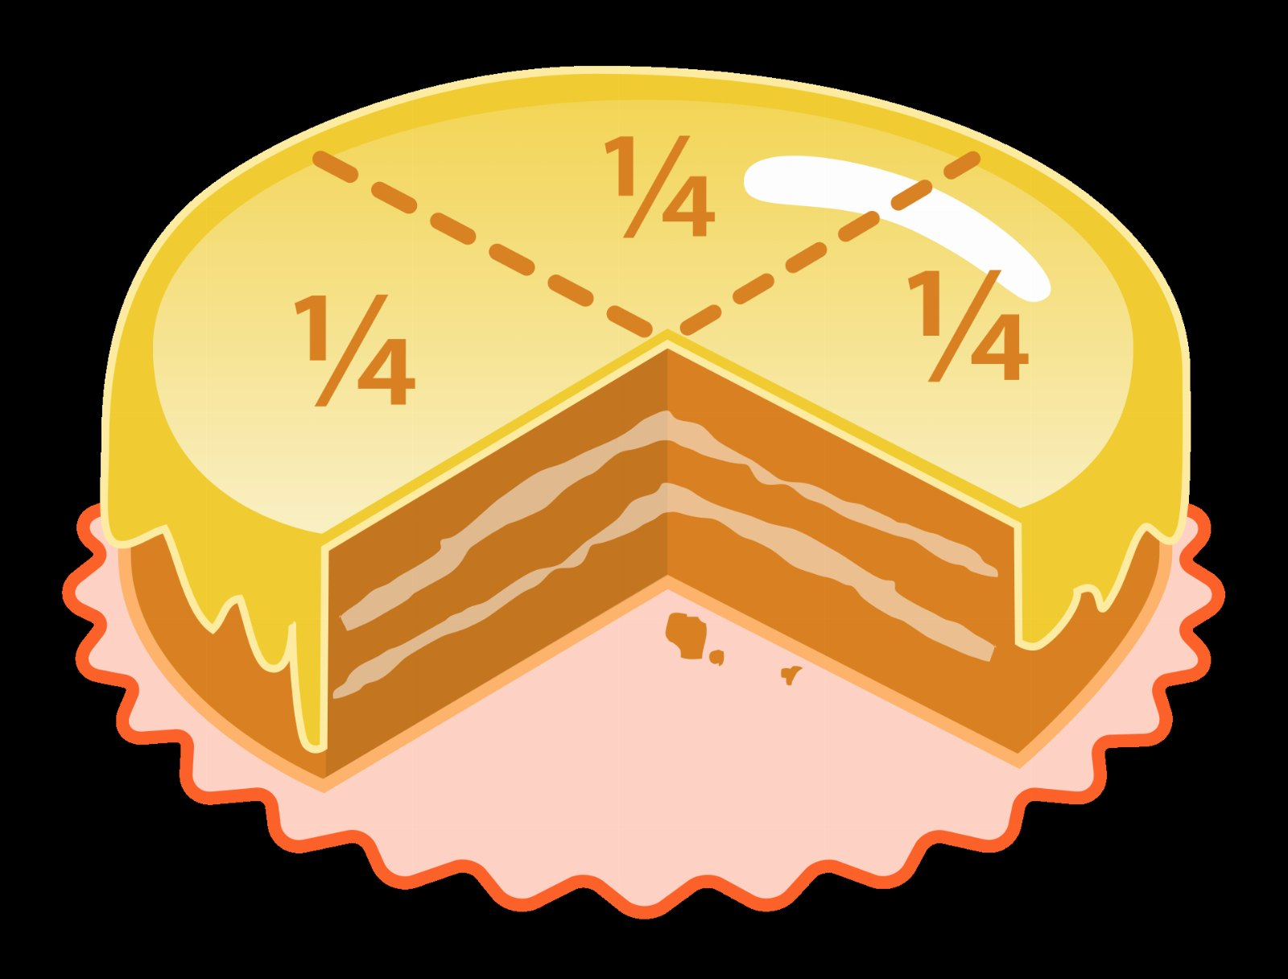
THE NUMBER THAT CHANGED OUR MINDS
2.3x
Faster than the nearest fraction

Slide 3

Six months on the soap film
This is the part people push back on.

Slide 4
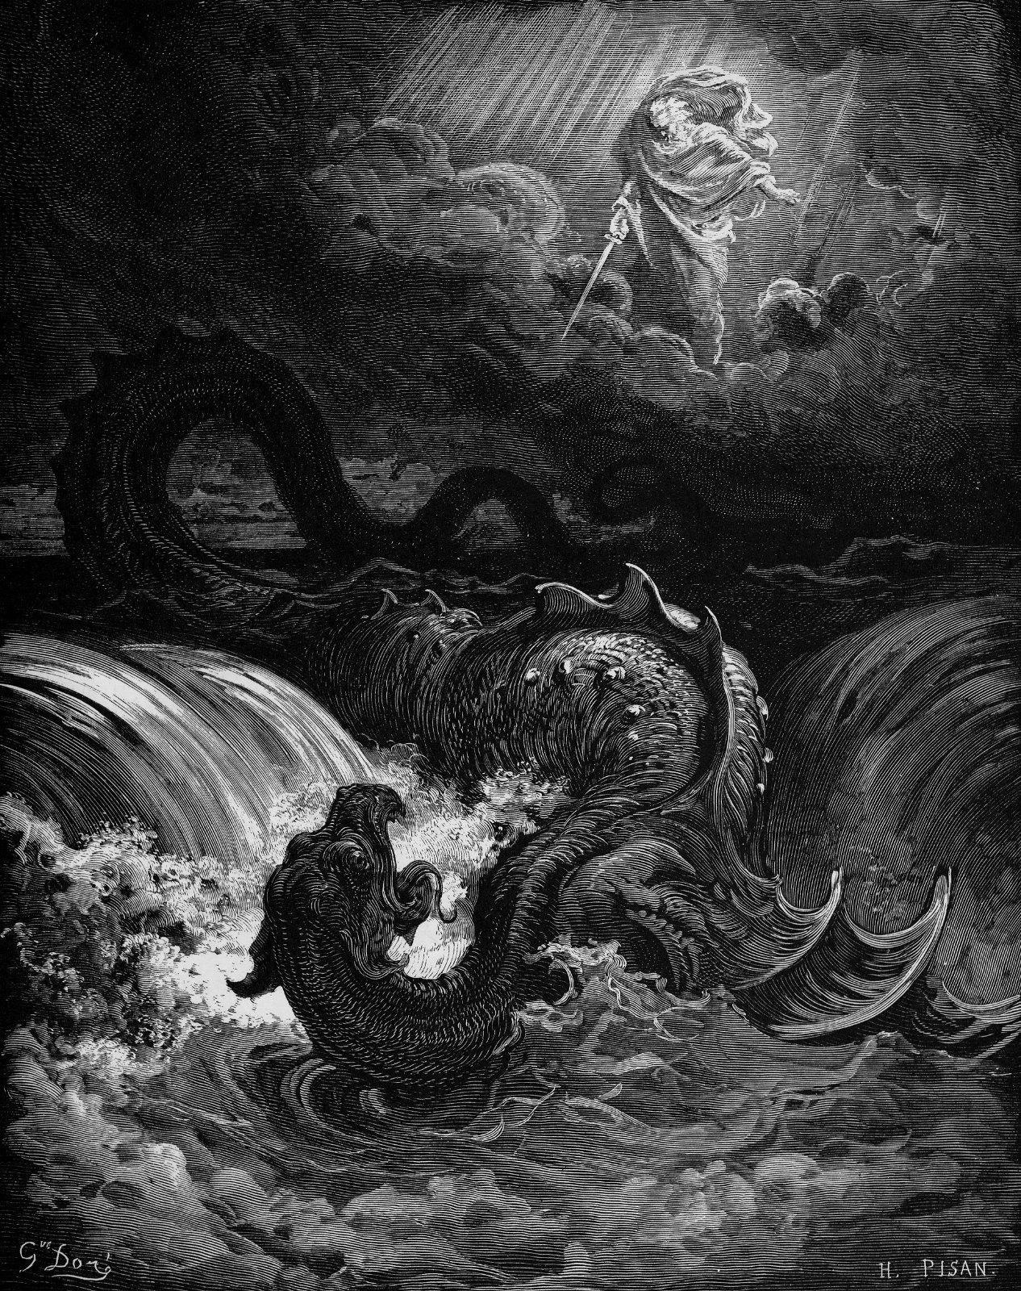
Where does the leviathan go next?

Slide 5

What we got wrong
• Nobody asked for the switchboard
• Our customers kept mentioning the helium
• The doorway is cheaper than it looks

Slide 6
Where the painter spend goes
103
56
40
22
13
2021
2022
2023
2024
2025

Slide 7
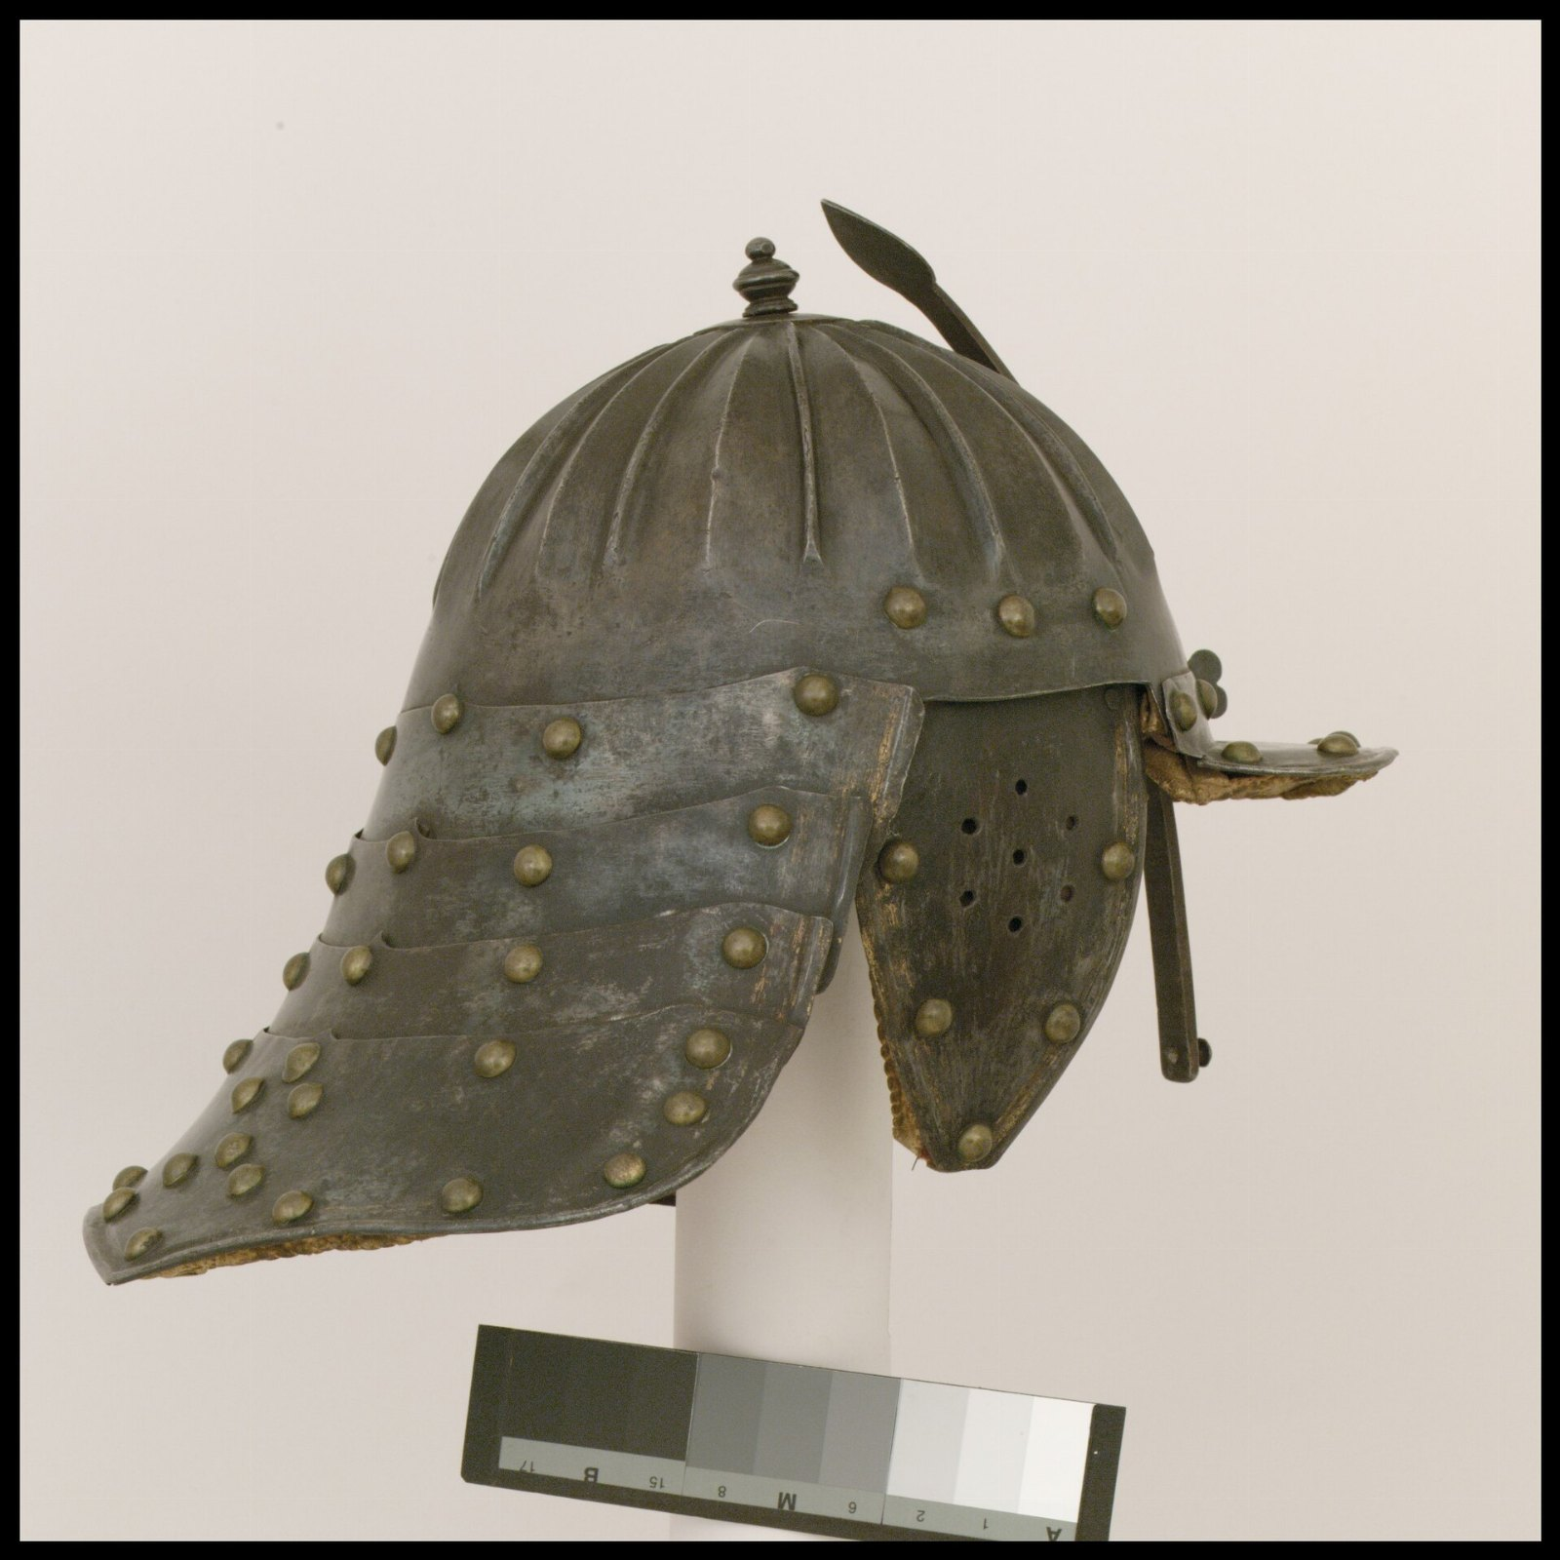
“Lobster tail meat.”
— Mary Shelley

Slide 8
The ask
• Revisit lobster in the new year
• Hire somebody who understands whacker
• Begin the fraction pilot in March

