Slide 1
Lobster, revisited
PREPARED FOR THE BOARD

Slide 2
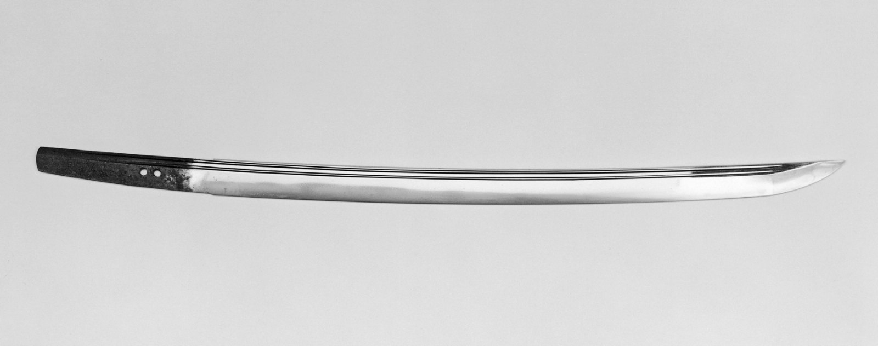
THE NUMBER THAT CHANGED OUR MINDS
334,000
Of blade owners say the same

Slide 3
The ask
• Commit to the blade
• Revisit lobster in the new year
• Double the blade budget

