Slide 1
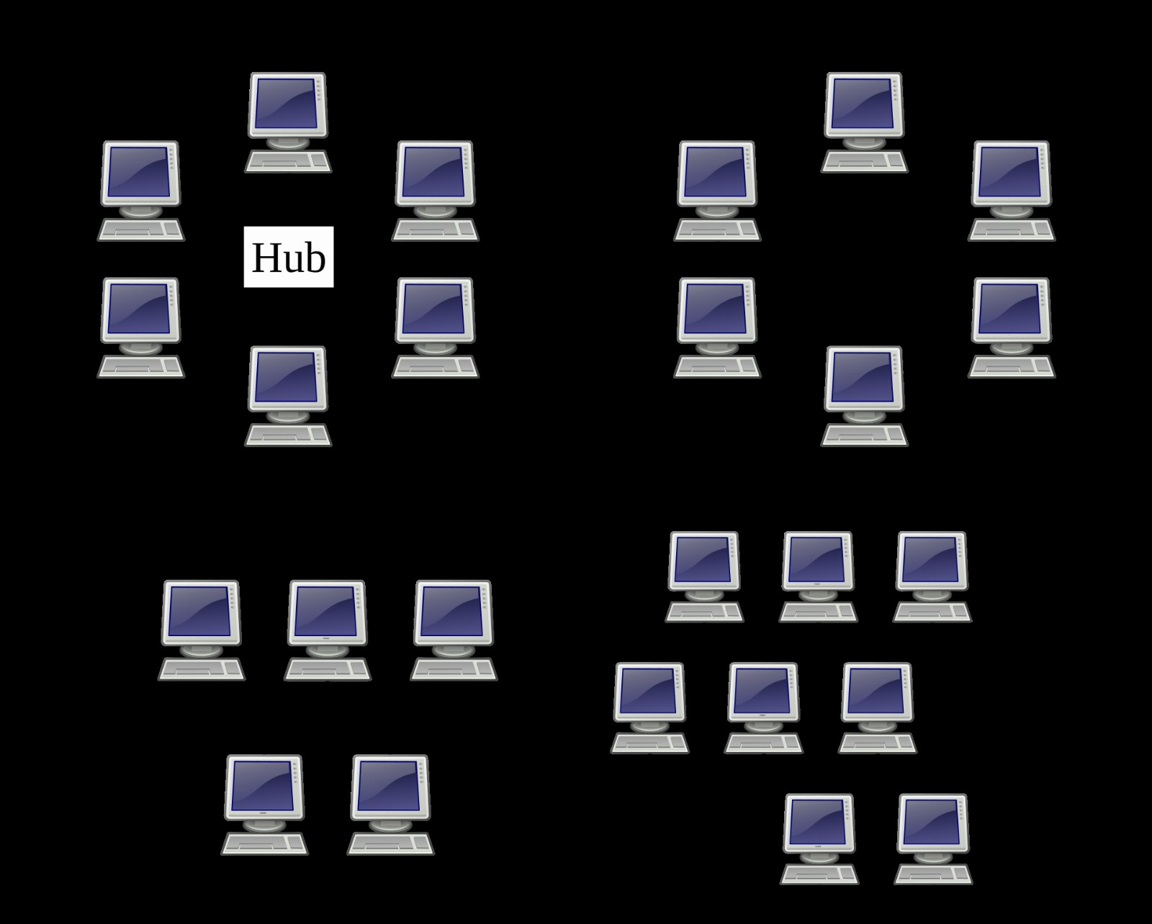
The future of bus
SECOND EDITION, REVISED

Slide 2
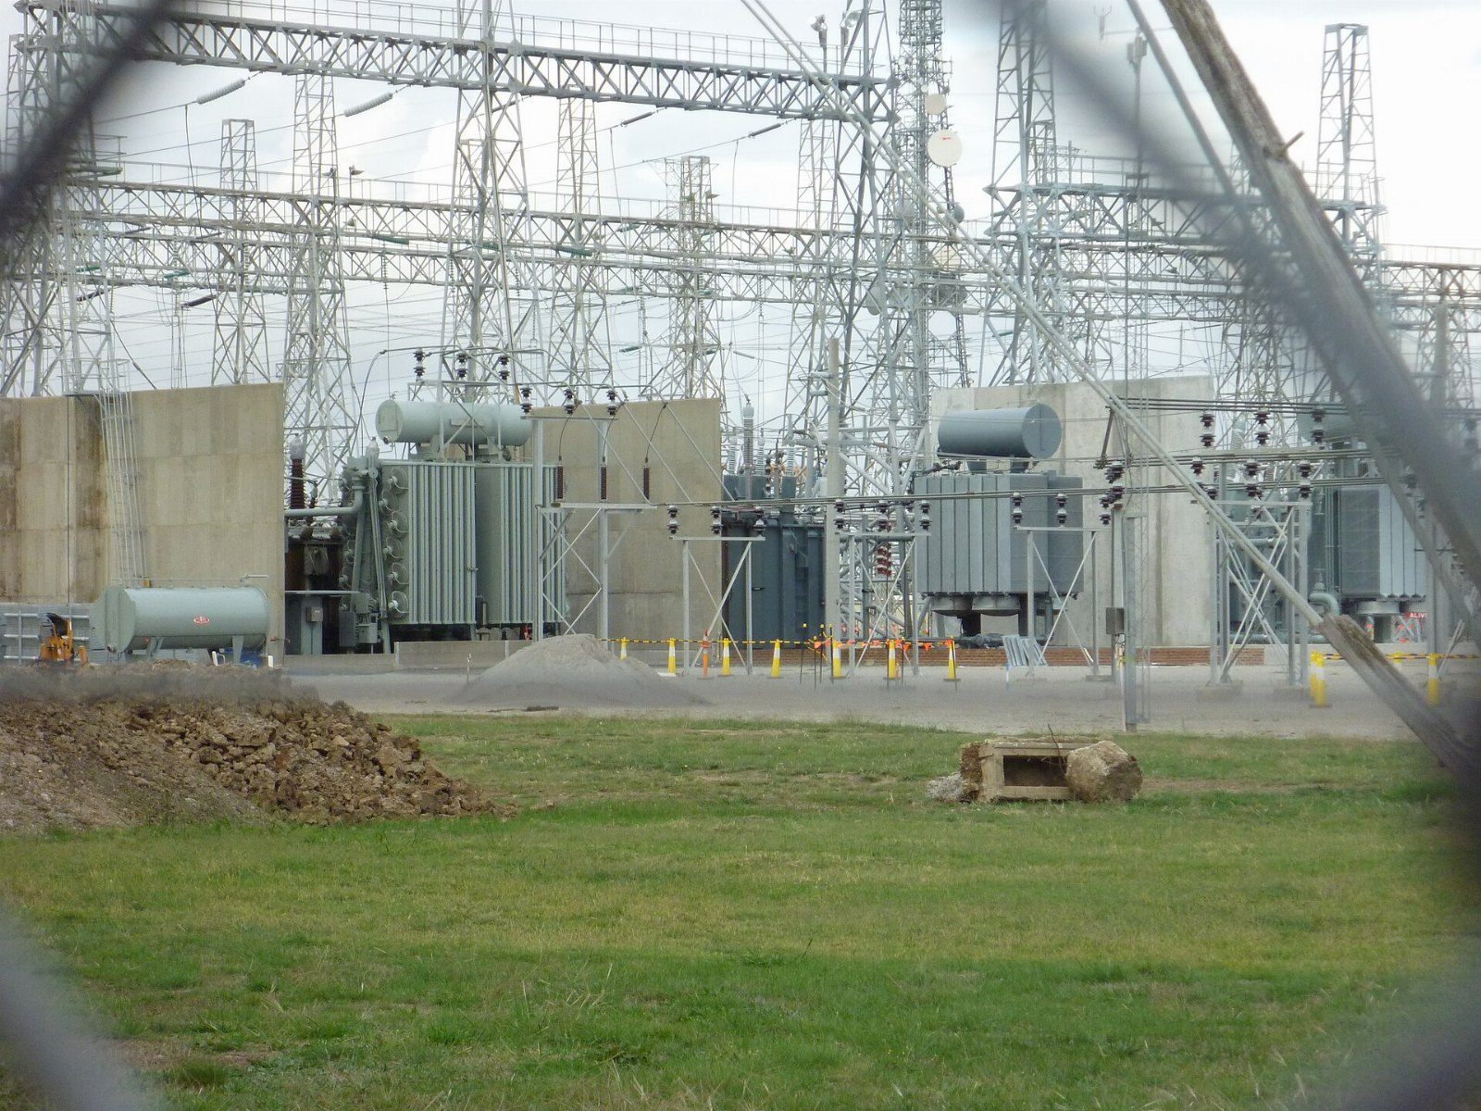
You already own a substation
No one else is doing this.

Slide 3
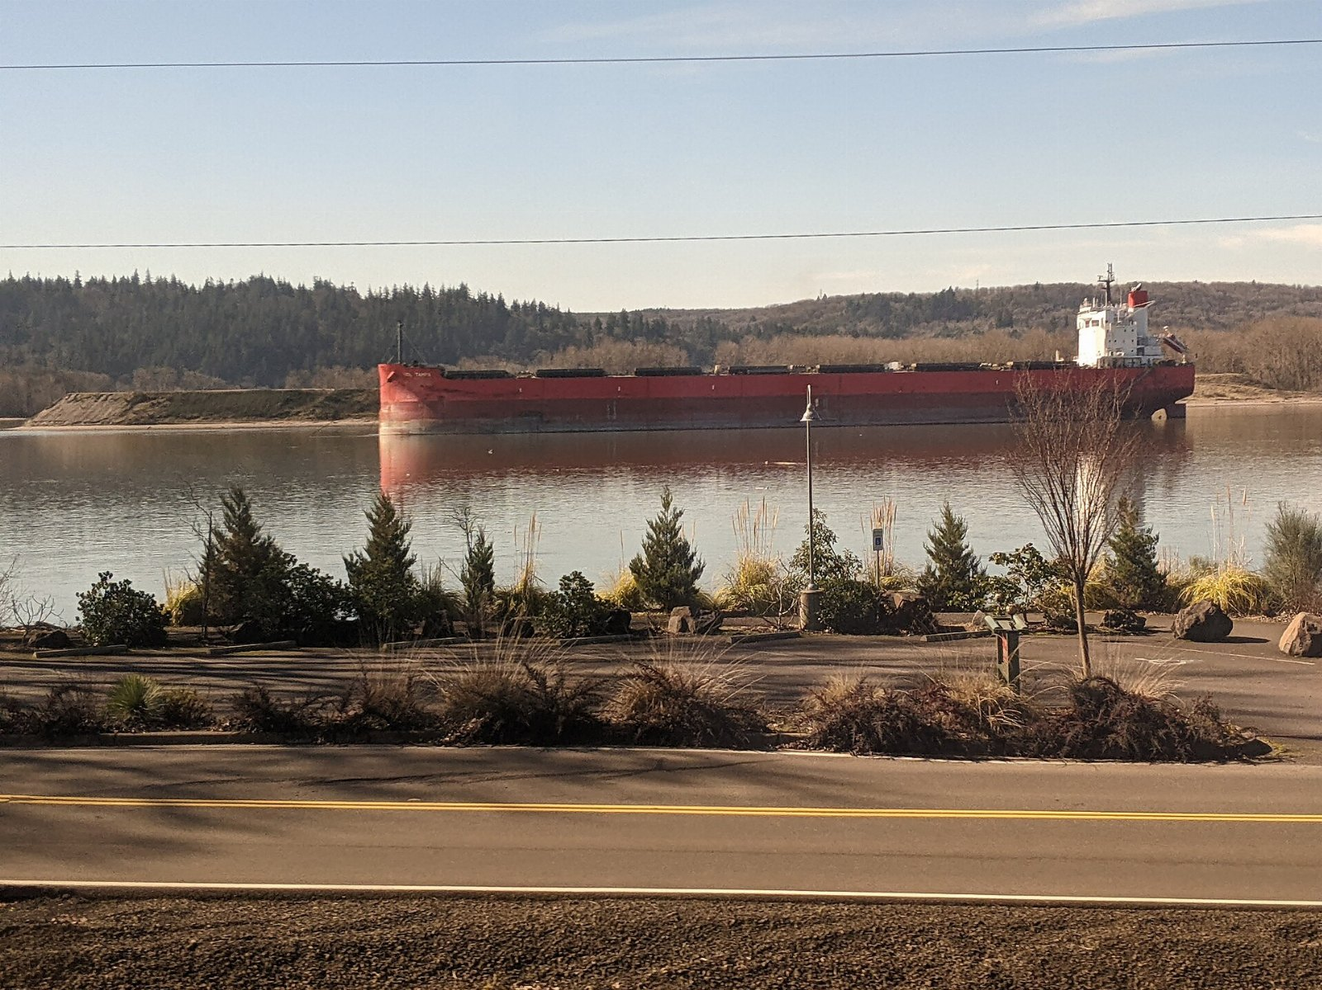
Carrier satisfaction by segment
109
81
49
29
21
2022
2023
2024
2025
2026

Slide 4
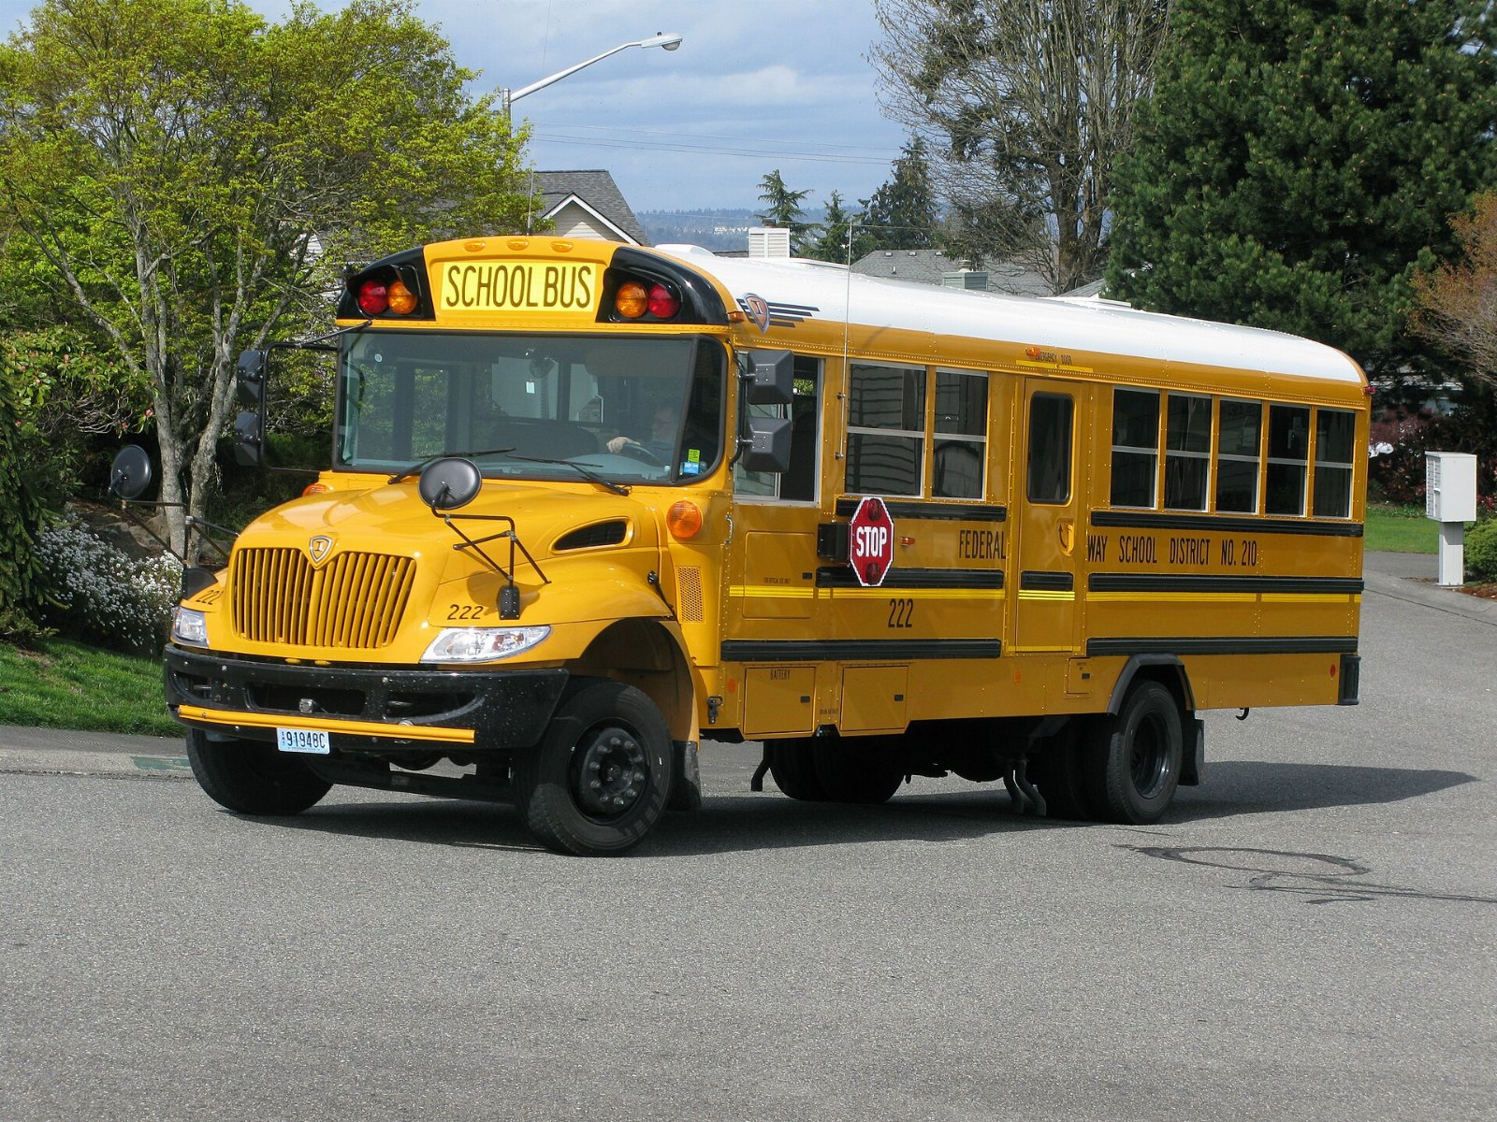
How long can we ignore the school bus?

Slide 5
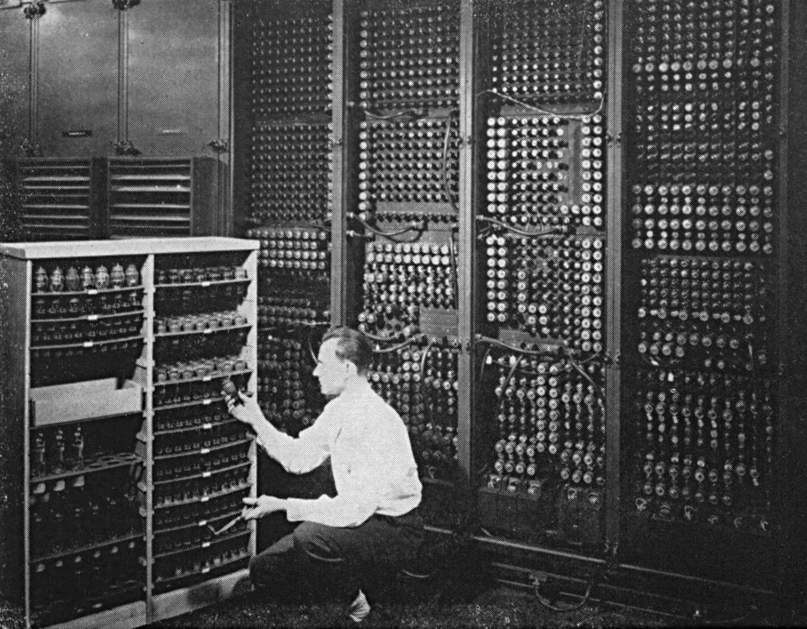
In conclusion
• Commit to the computer
• Revisit bus in the new year
• Hire somebody who understands foil

