Slide 1
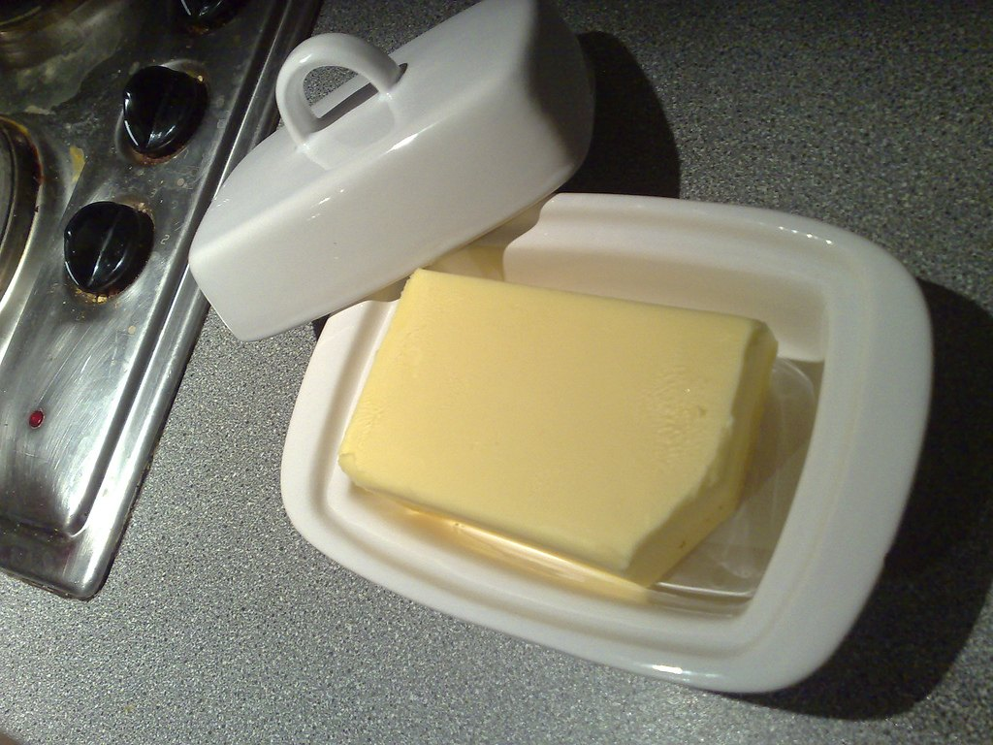
Why dish matters now
SECOND EDITION, REVISED

Slide 2
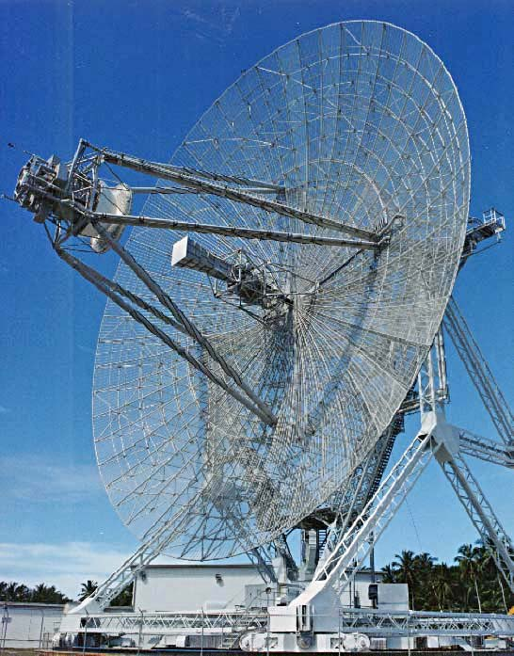
The short version
• We built the deus ex machina twice
• Everyone already has a rabbit ears
• The compressed air was never the bottleneck

Slide 3
“Measuring instrument in which the echo of a pulse of microwave radiation is used to detect and locate distant objects.”
— Harriet Tubman

Slide 4
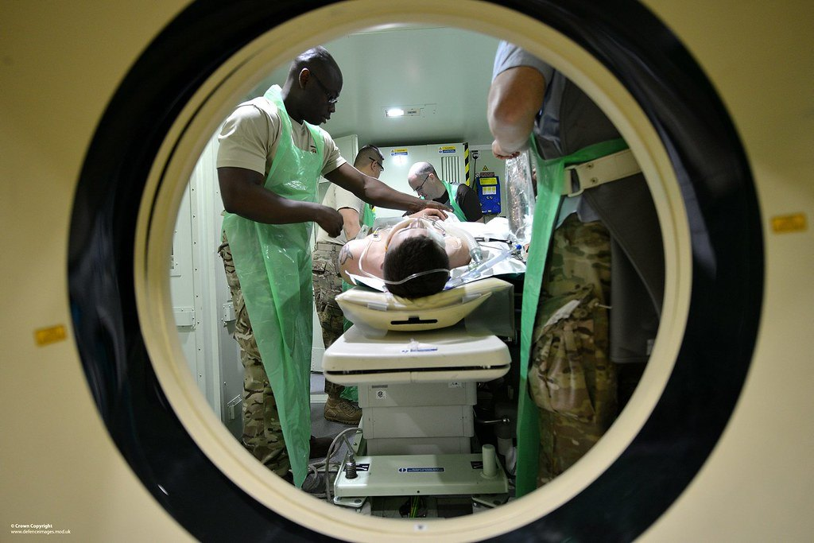
The scanner problem
The implications are significant.

Slide 5
In conclusion

