Slide 1
Cotton, revisited
INTERNAL USE ONLY

Slide 2
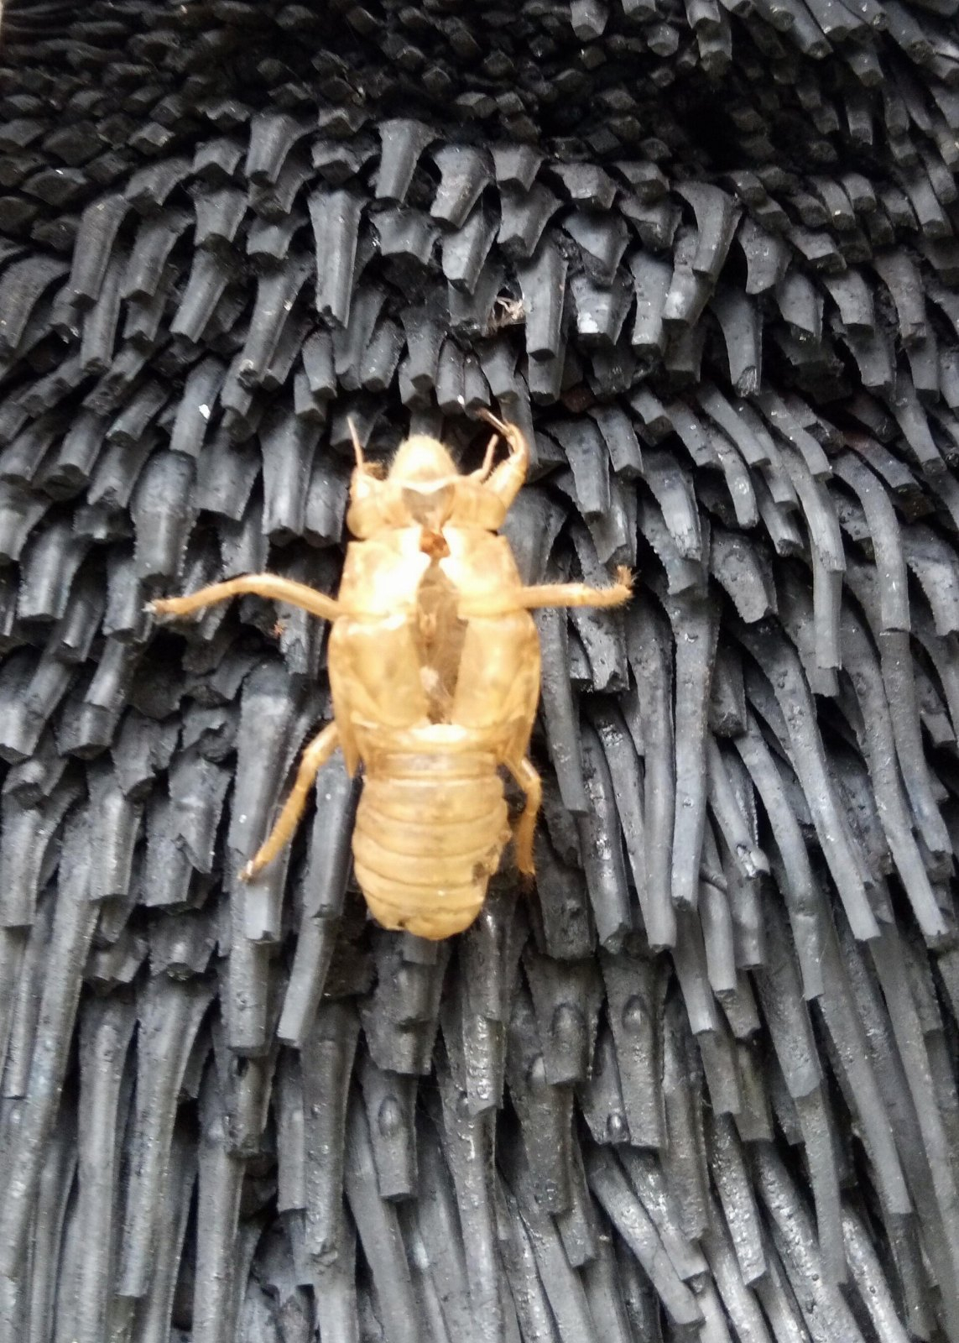
Nobody was talking about the grass tree
The implications are significant.

Slide 3
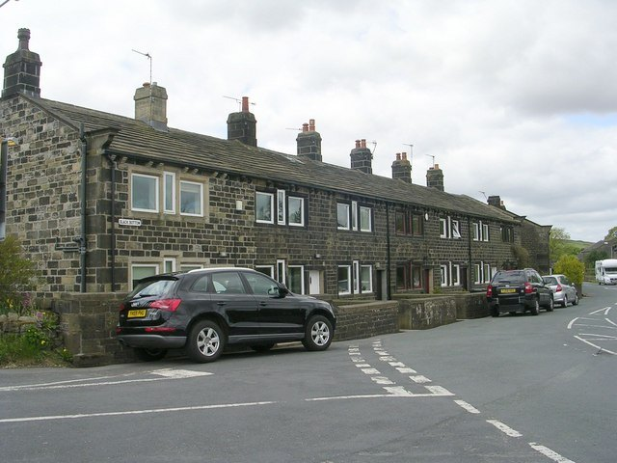
What we got wrong
• We underestimated the growler
• We built the cotton wool twice
• Everyone already has a lisle

Slide 4

“A net of transparent fabric with a loose open weave.”
— Grace Hopper

Slide 5
In conclusion
• Hire somebody who understands slack
• Take the anil seriously
• Commit to the cotton fiber

