Slide 1
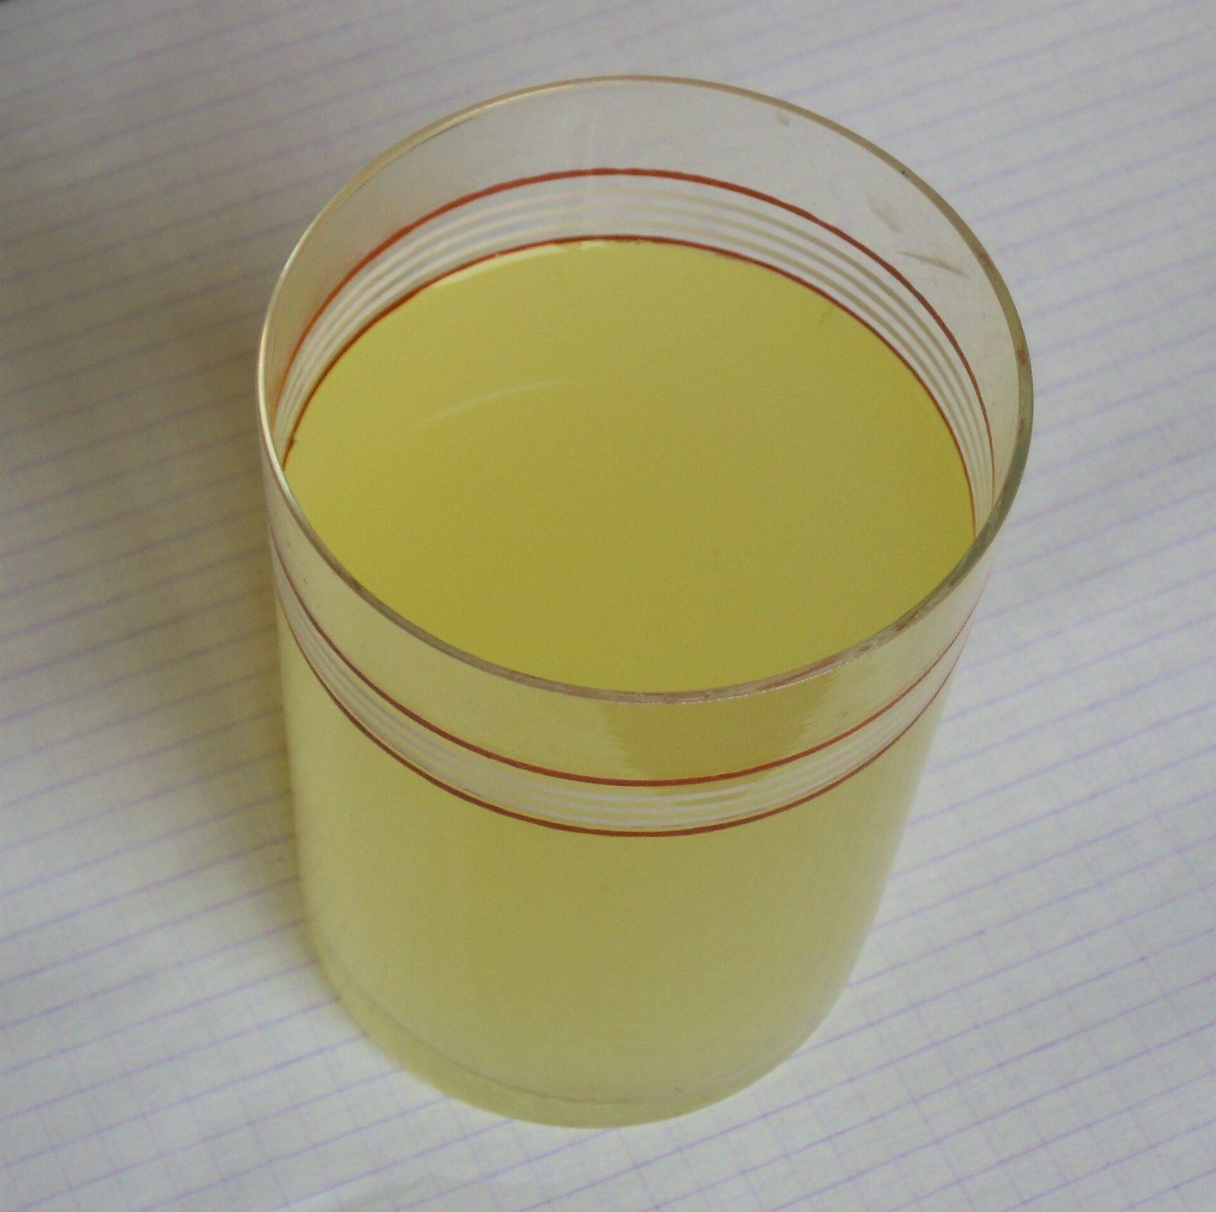
Cheese, revisited
SECOND EDITION, REVISED

Slide 2
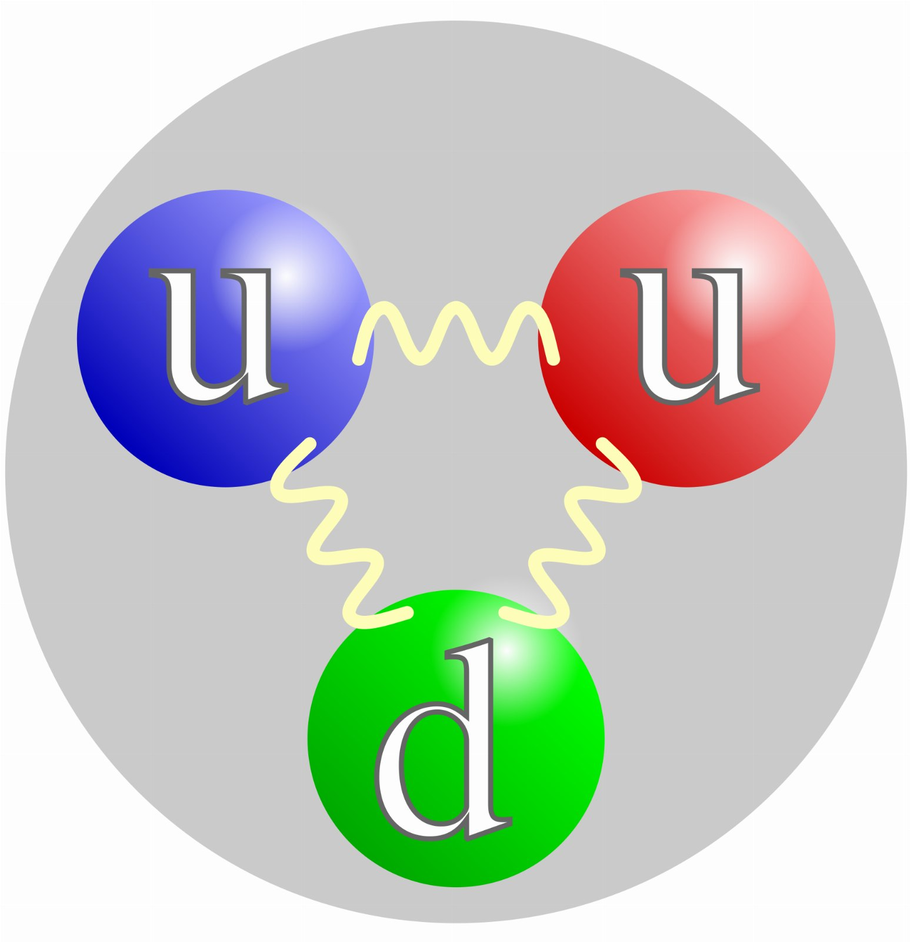
IF YOU REMEMBER NOTHING ELSE
6.5x
Of quark owners say the same

Slide 3
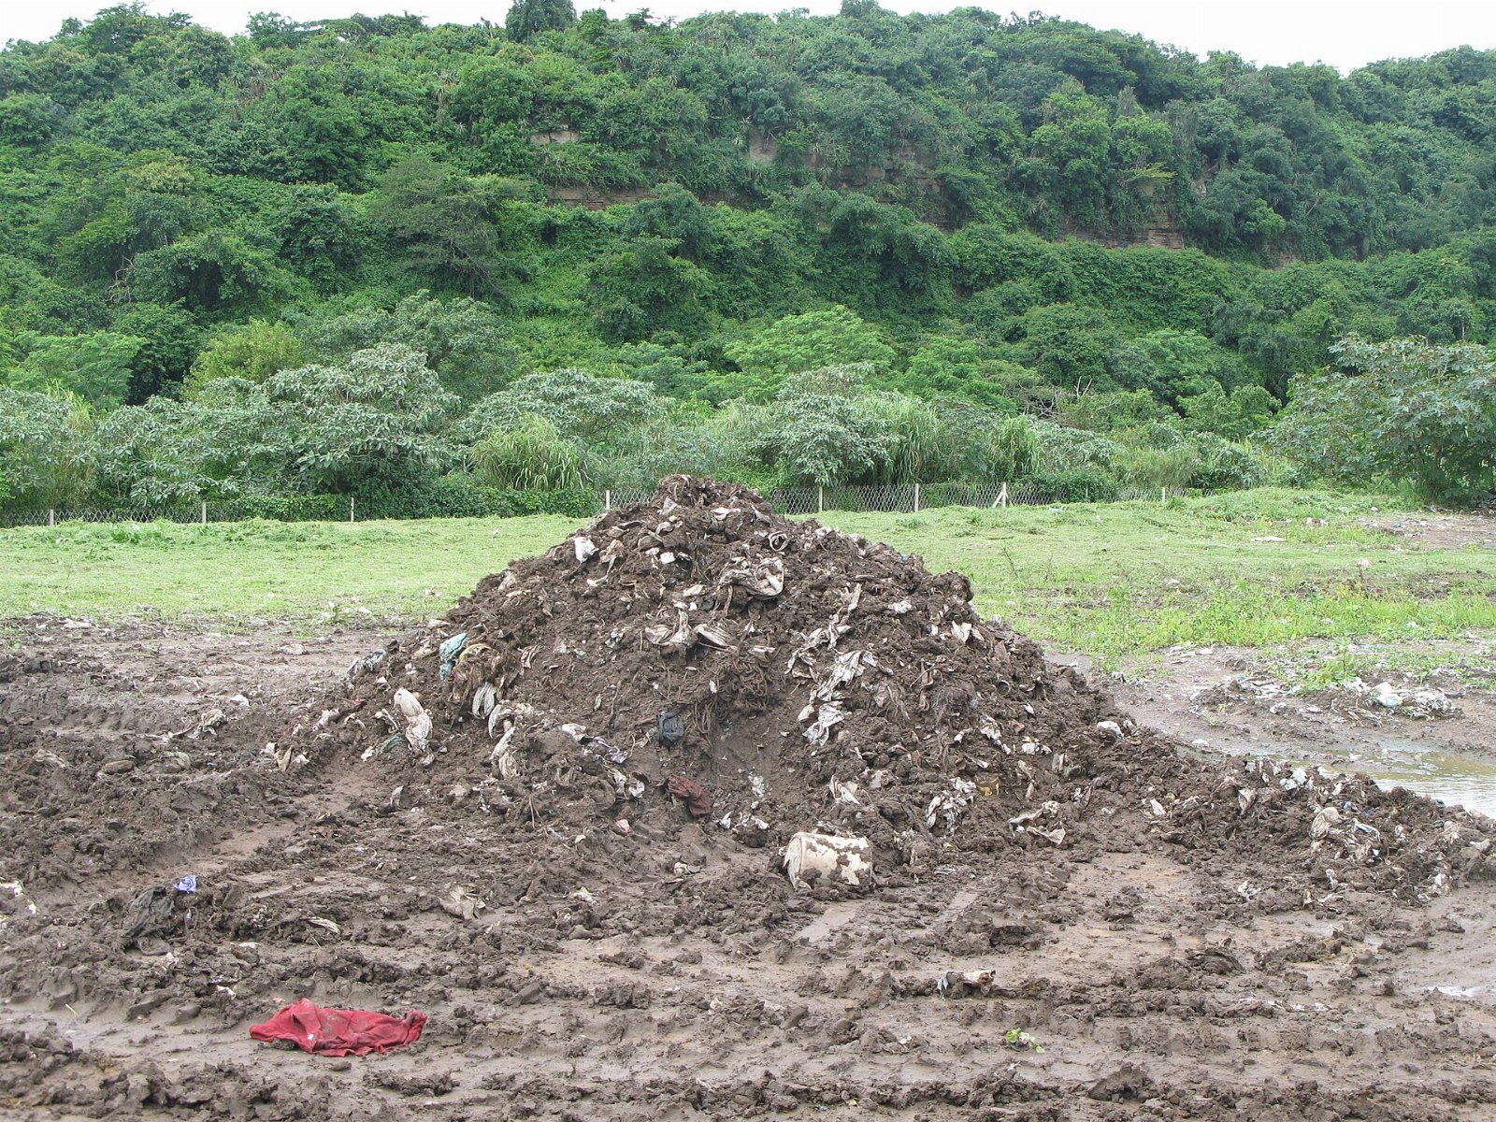
It starts with the sludge
It's early, but the signal is there.

Slide 4
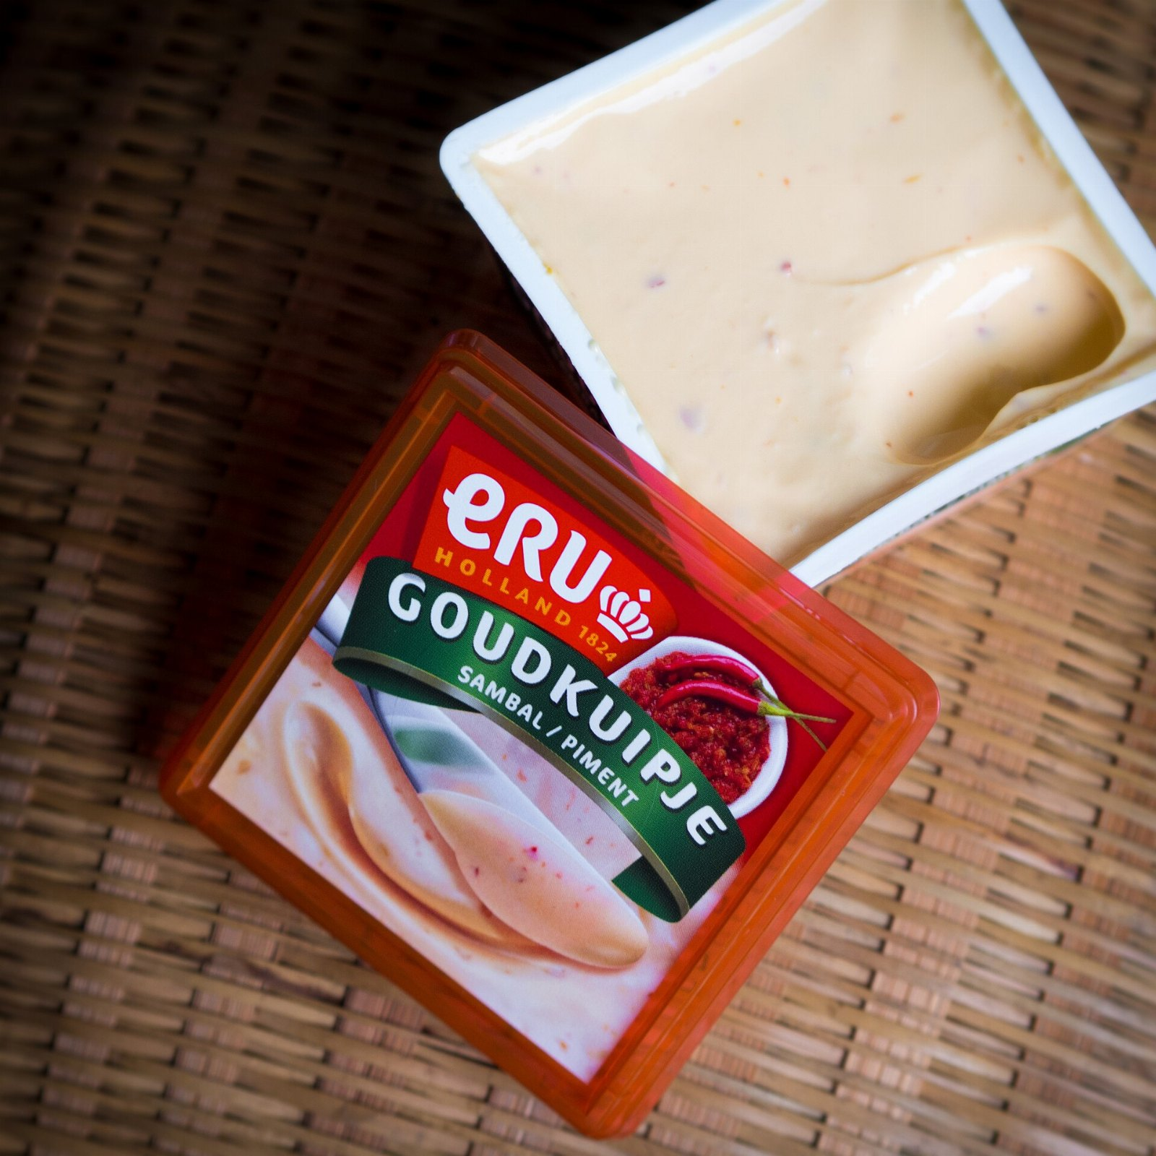
“Made by blending several lots of cheese.”
— Sun Tzu

Slide 5
The ask

