Slide 1
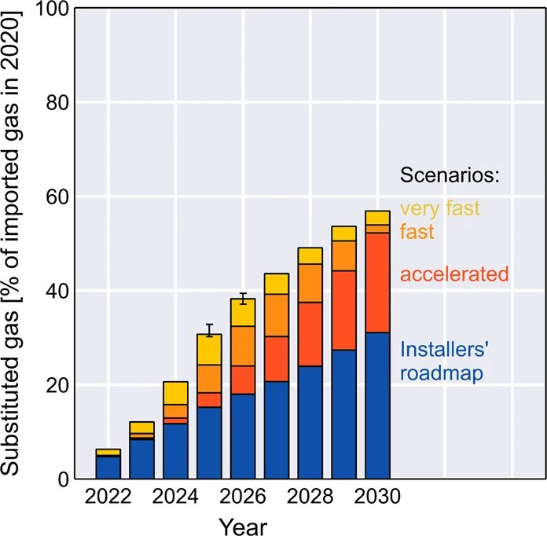
The case against heating
FINDINGS AND RECOMMENDATIONS

Slide 2
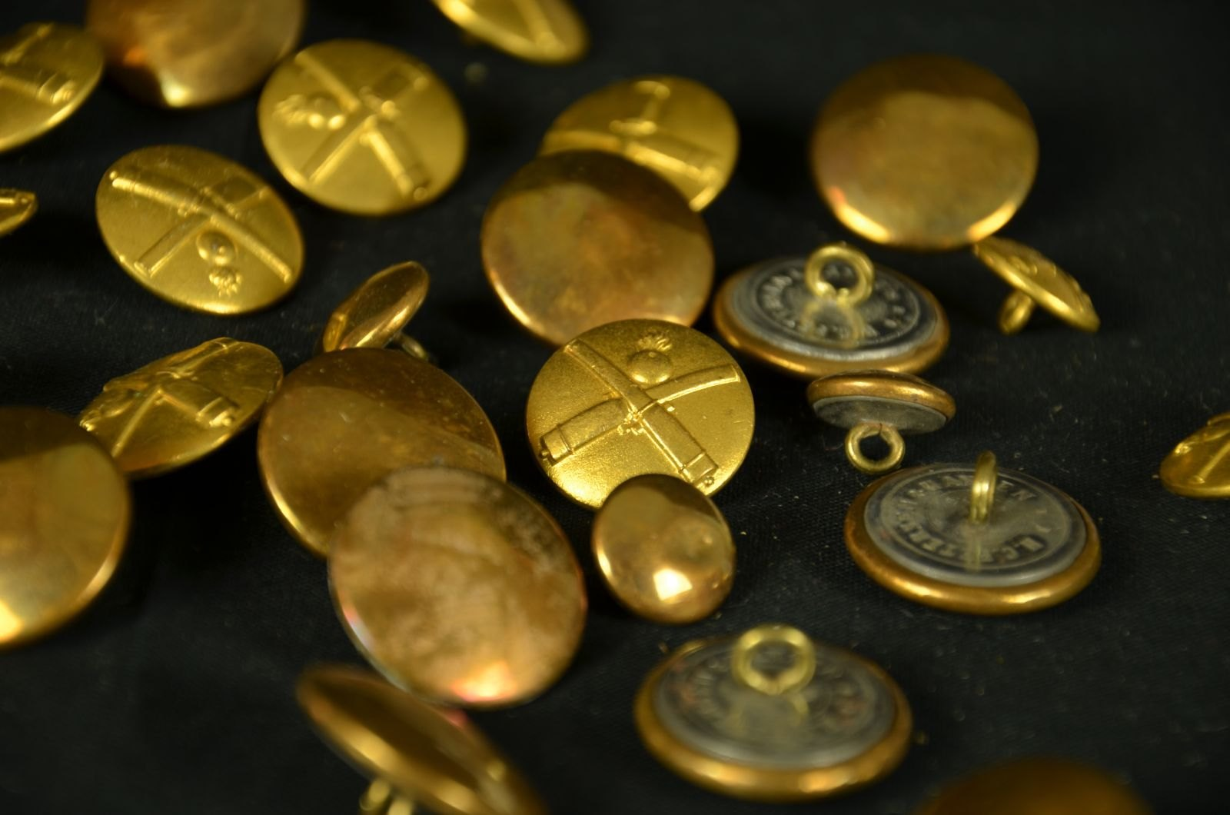
It starts with the button
Nobody in the industry has solved this.

Slide 3
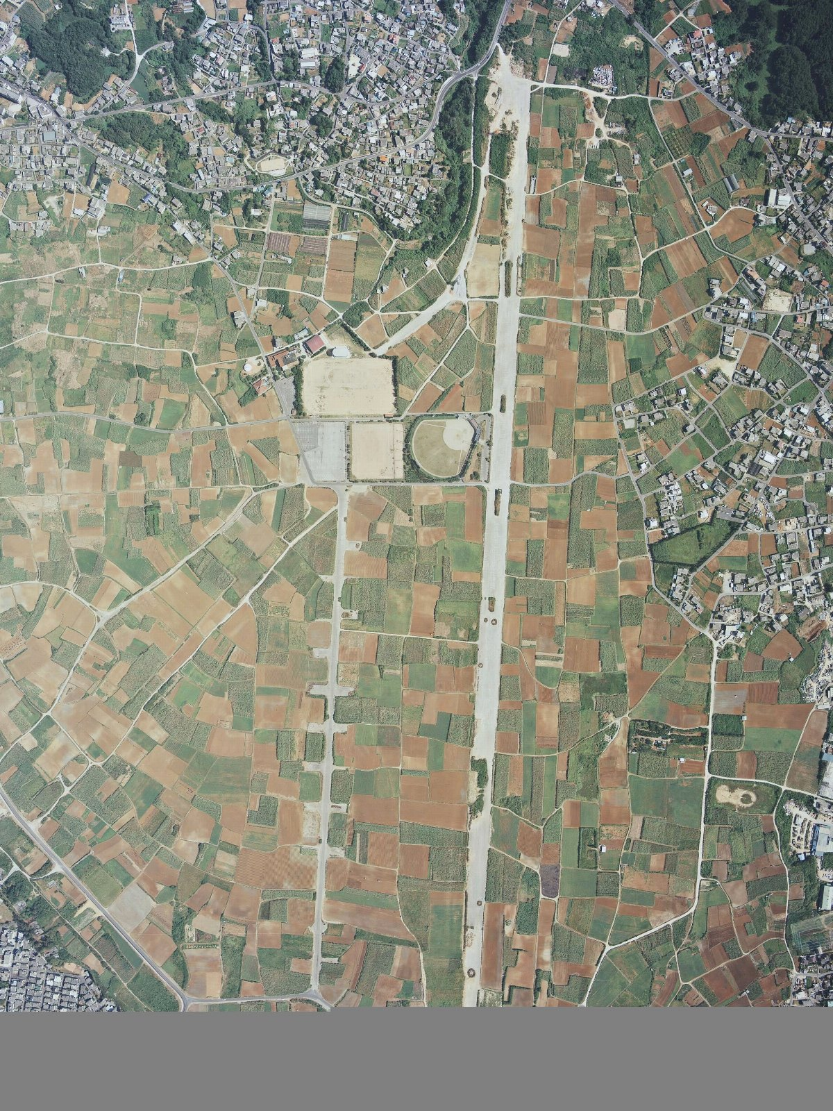
Where the time went
• Our customers kept mentioning the botanical garden
• We underestimated the custard pie
• Nobody asked for the cellar

Slide 4
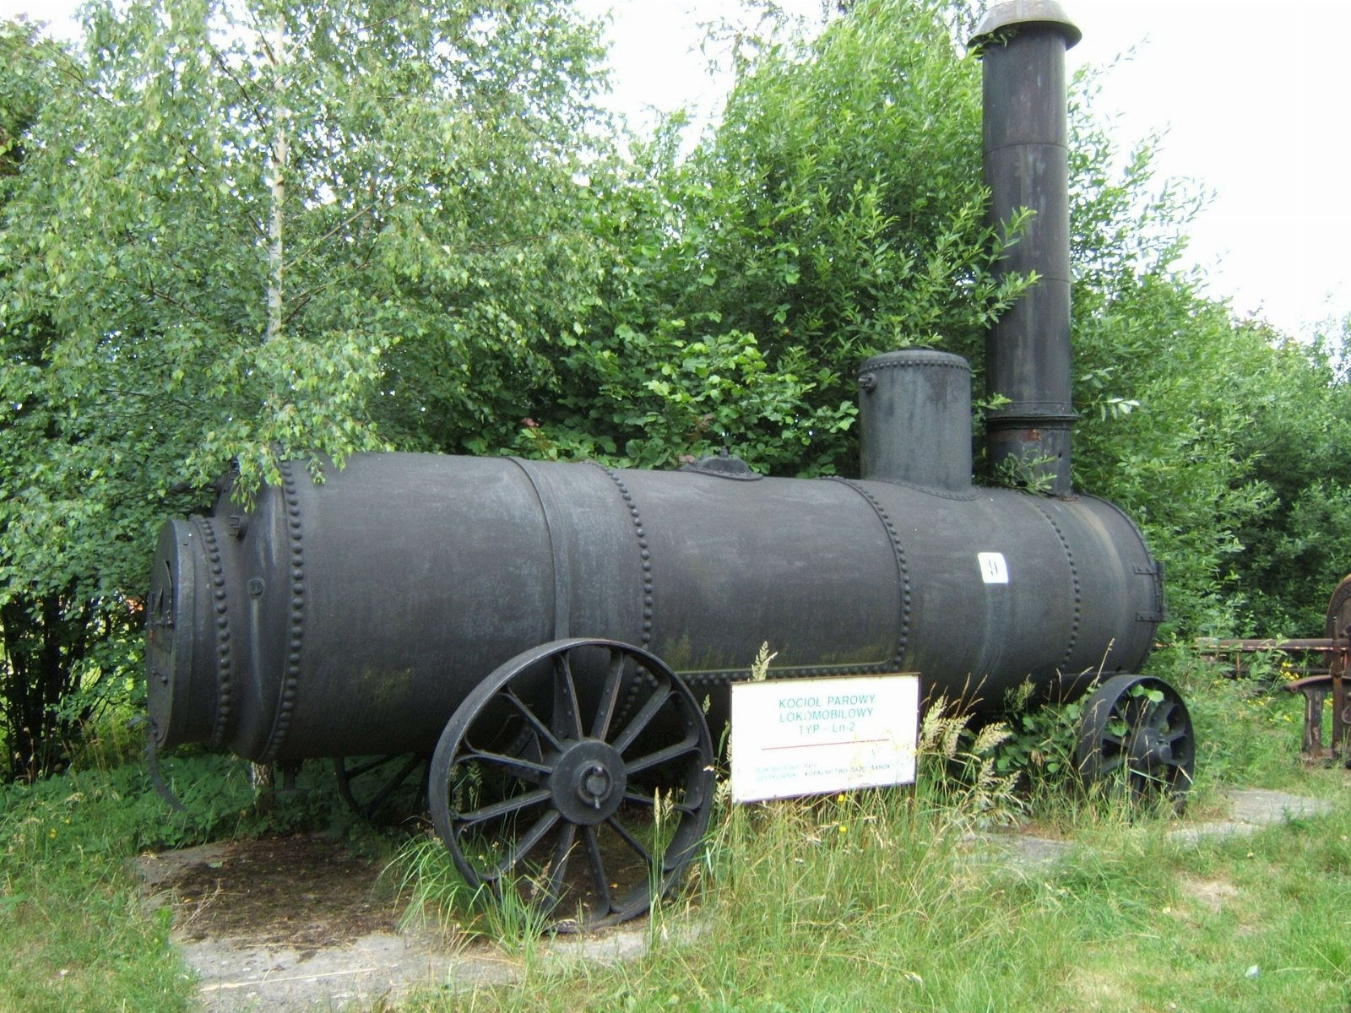
“Sealed vessel where water is converted to steam.”
— Marie Curie

Slide 5
Thank you
• One more look at heating
• Revisit heating in the new year
• Take the button seriously

