Slide 1
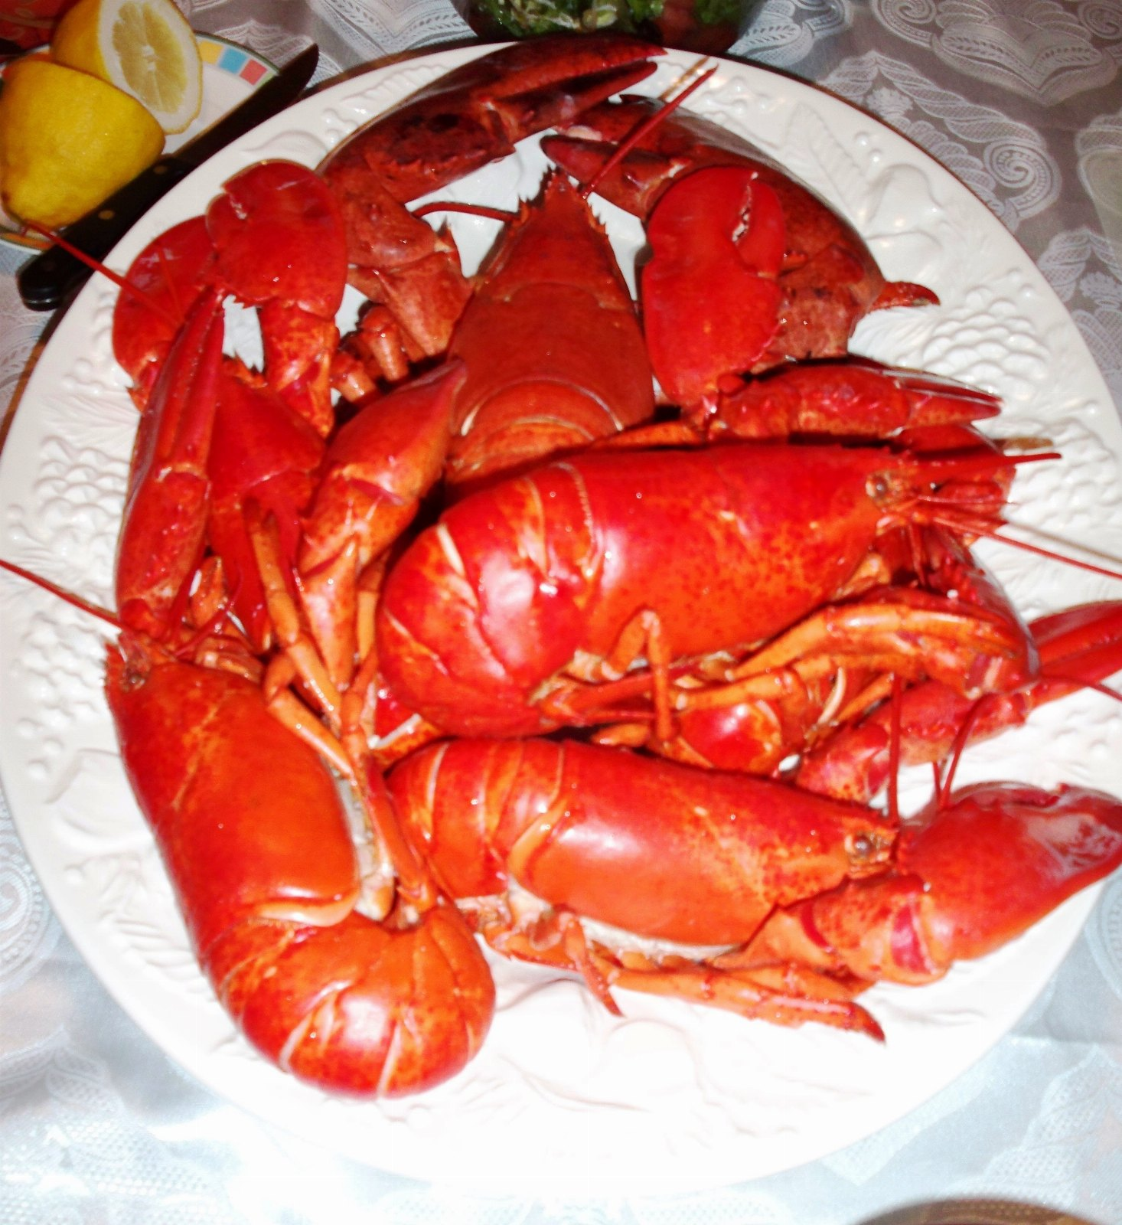
Lobster: a candid assessment
DRAFT: PLEASE DO NOT CIRCULATE

Slide 2
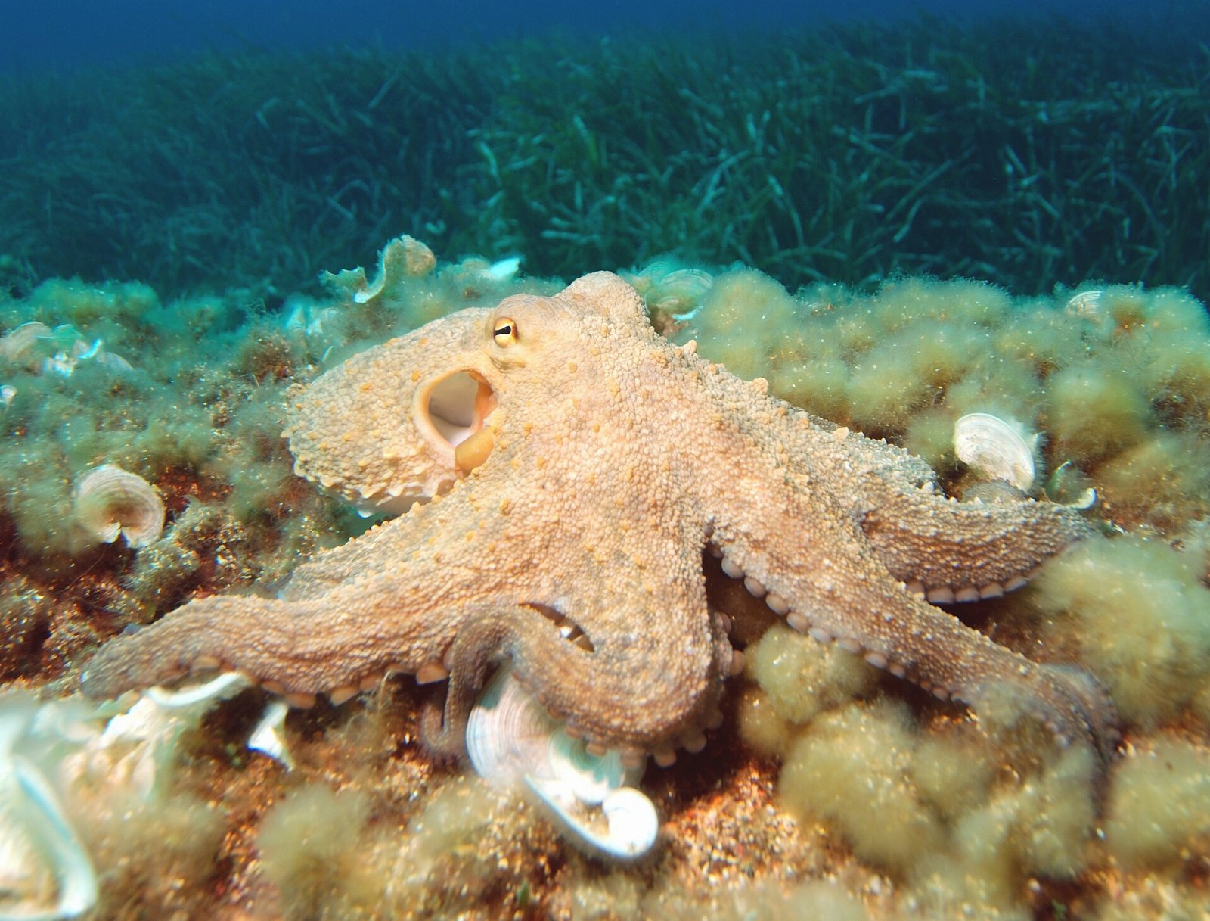
ONE FIGURE
967,000
Of the market is still unserved

Slide 3
What the octopus told us
• Everyone already has a leftovers
• The steamer doesn't scale
• We built the beluga caviar twice

Slide 4
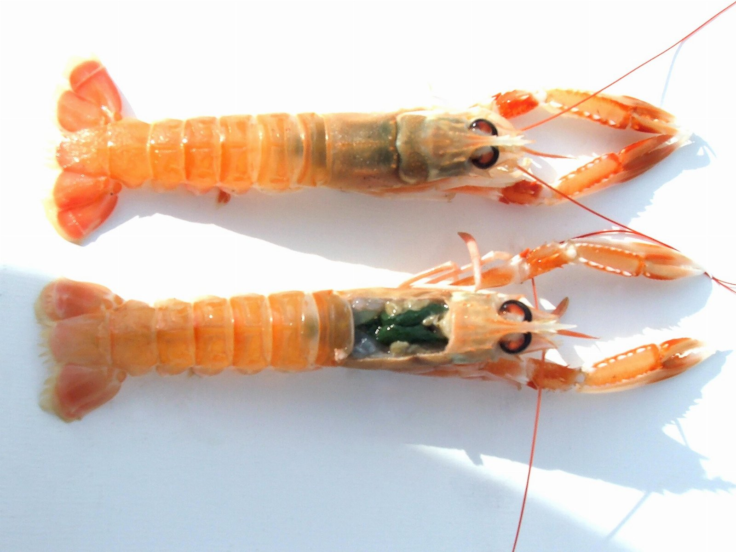
The langoustine gap
76
46
34
20
12
2022
2023
2024
2025
2026

Slide 5
The ask
• Double the octopus budget
• Hire somebody who understands leftovers
• Commit to the steamer

