Slide 1
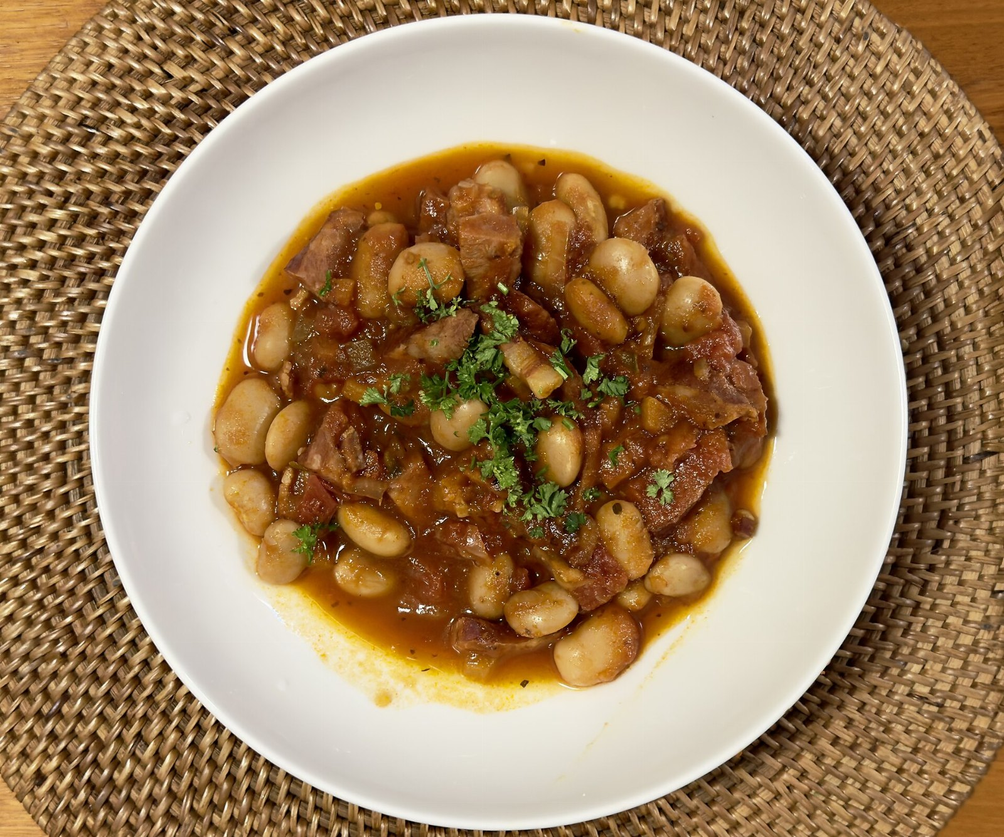
The case against frank
CONFIDENTIAL

Slide 2
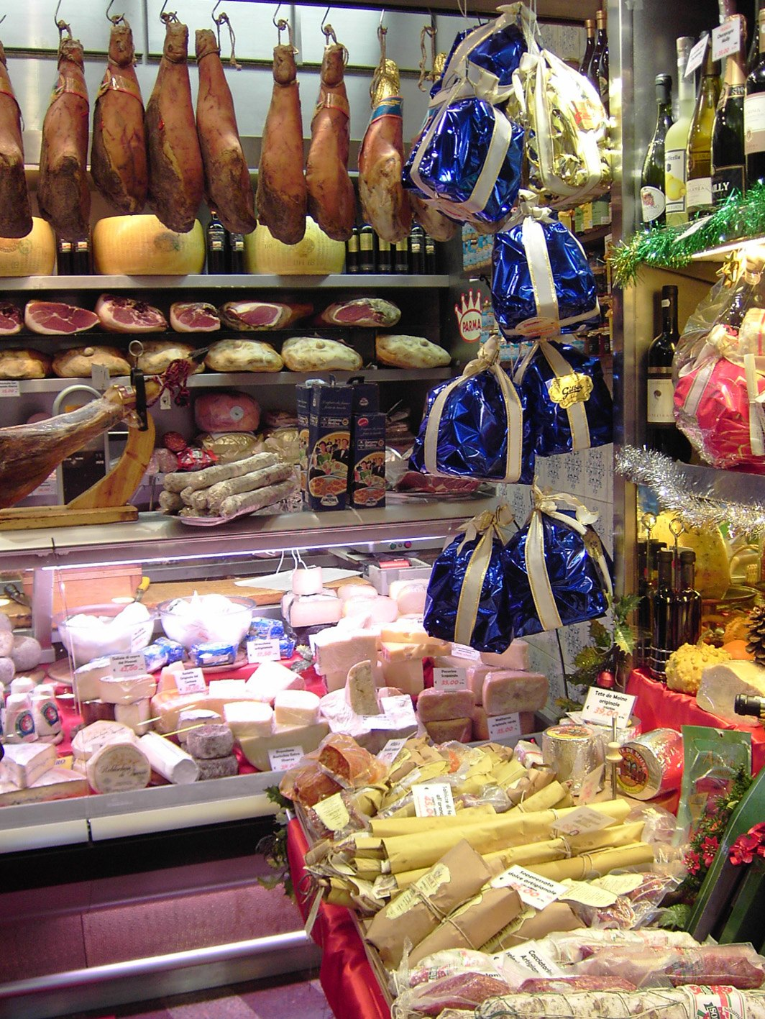
The delicatessen problem
The implications are significant.

Slide 3
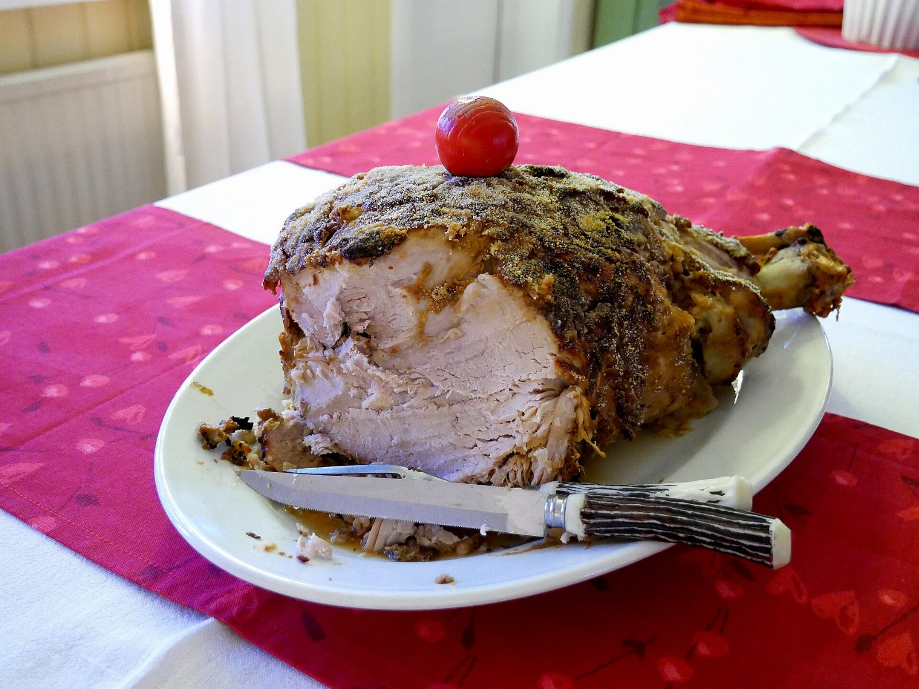
“Meat that is dark in color before cooking.”
— Sun Tzu

Slide 4
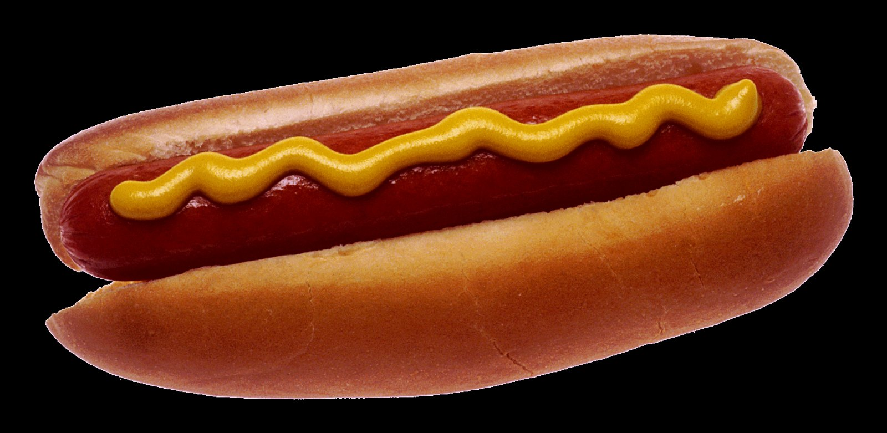
Hot dog: projected growth
141
78
38
32
17
2021
2022
2023
2024
2025

Slide 5
In conclusion
• Revisit frank in the new year
• Double the red meat budget
• Begin the delicatessen pilot in March

