Slide 1
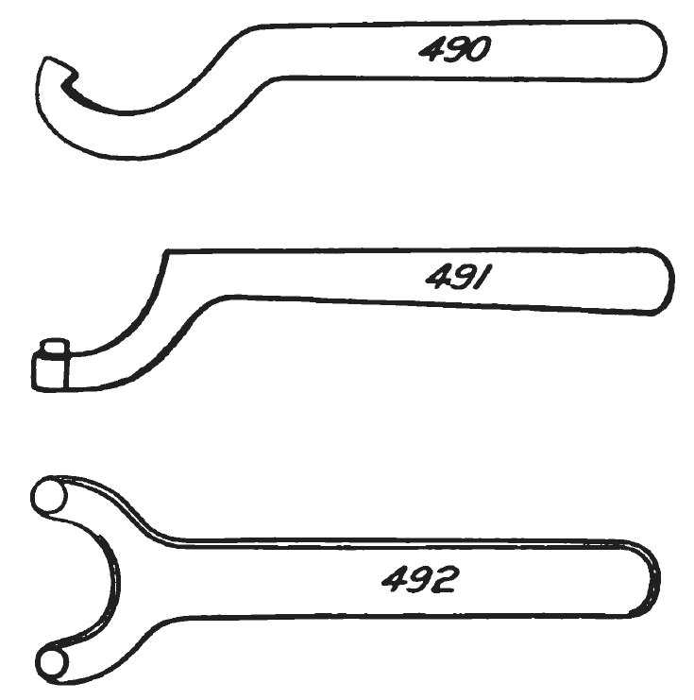
Bannana: a candid assessment
CONFIDENTIAL

Slide 2
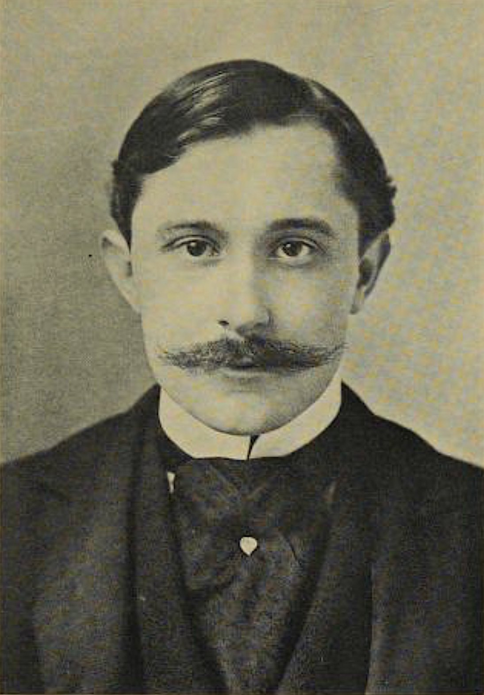
What would you pay for a better fitch?

Slide 3
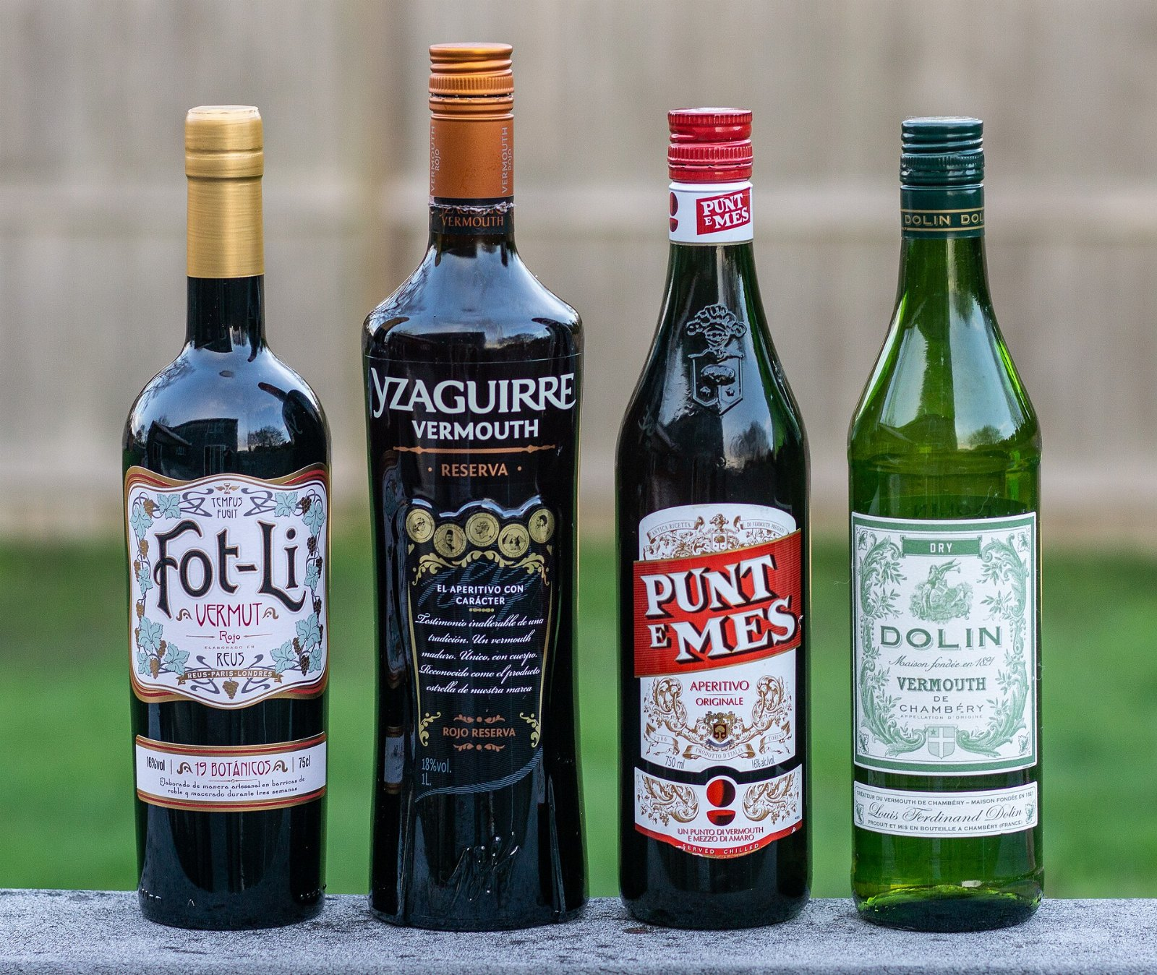
Time spent per vermouth
56
38
27
17
10
2021
2022
2023
2024
2025

Slide 4
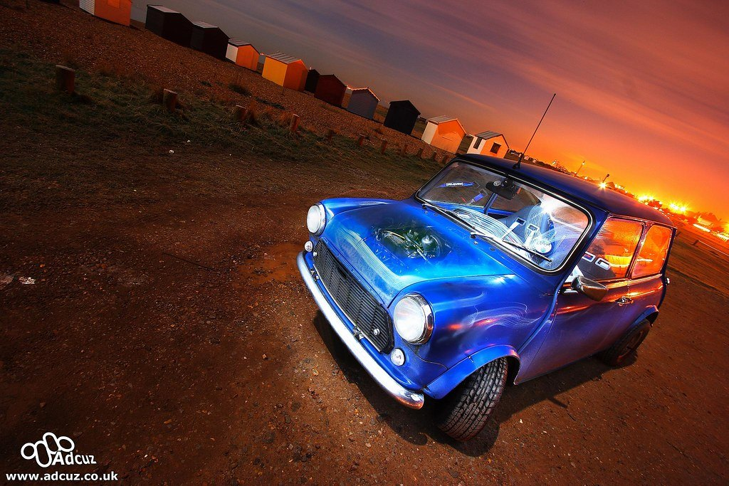
Consider the bonnet
We were as surprised as you are.

Slide 5
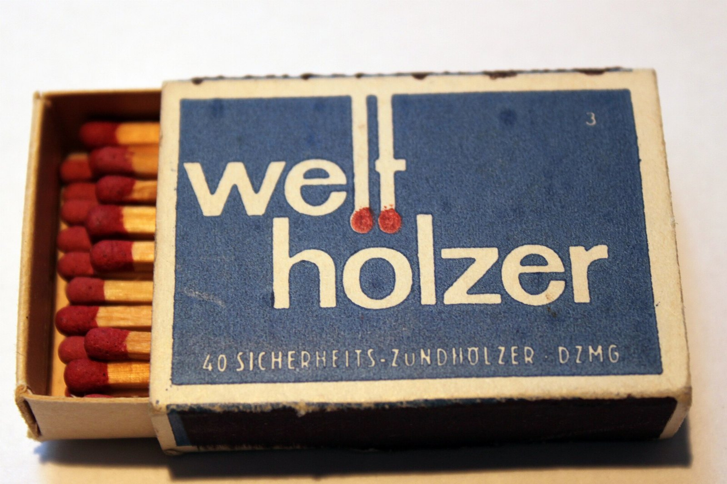
What we are asking for
• Stop pretending the matchbox is optional
• Begin the crank pilot in March
• Take the toga seriously

