Slide 1
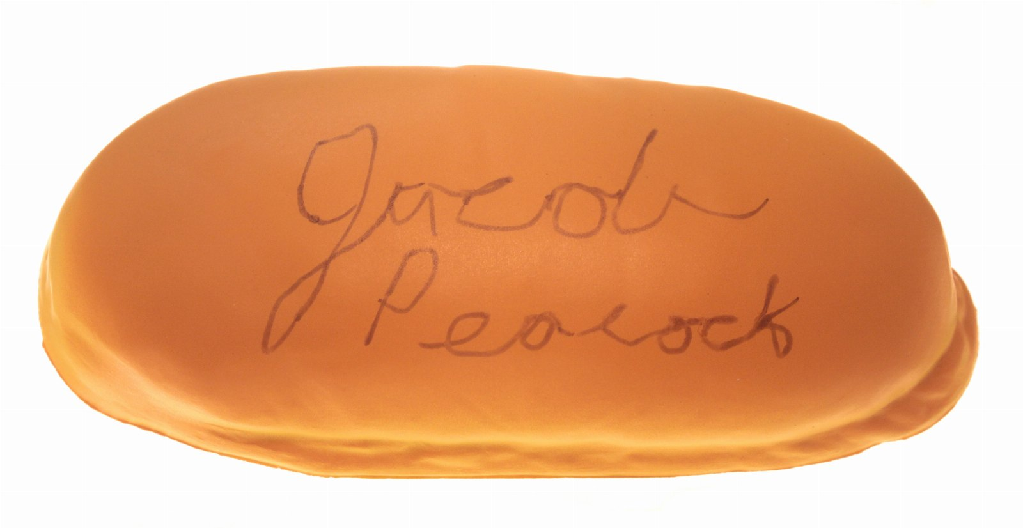
The future of hot dog
CONFIDENTIAL

Slide 2
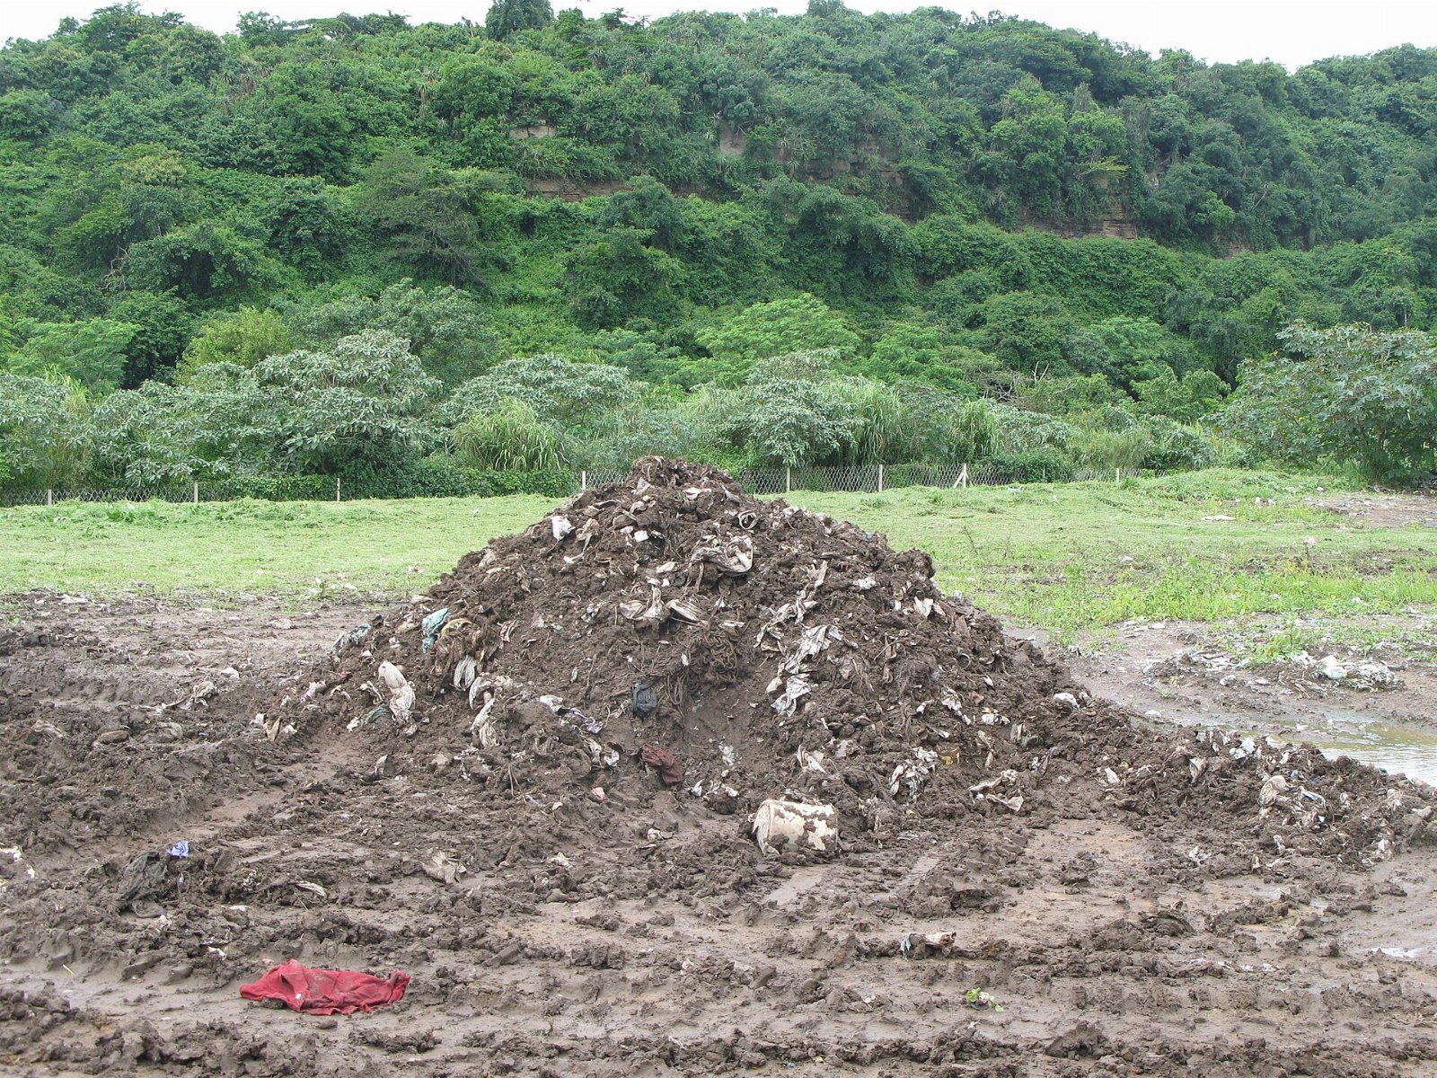
“The precipitate produced by sewage treatment.”
— Mary Shelley

Slide 3
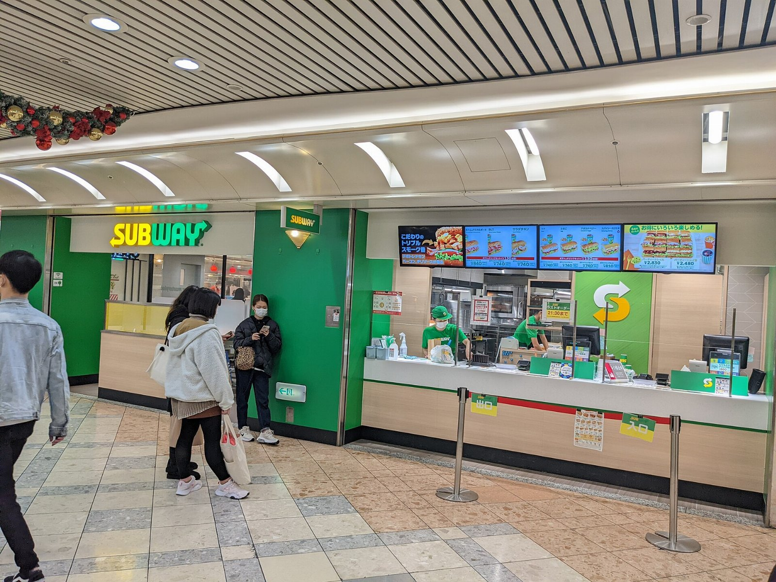
Is the hotdog really the problem?

Slide 4
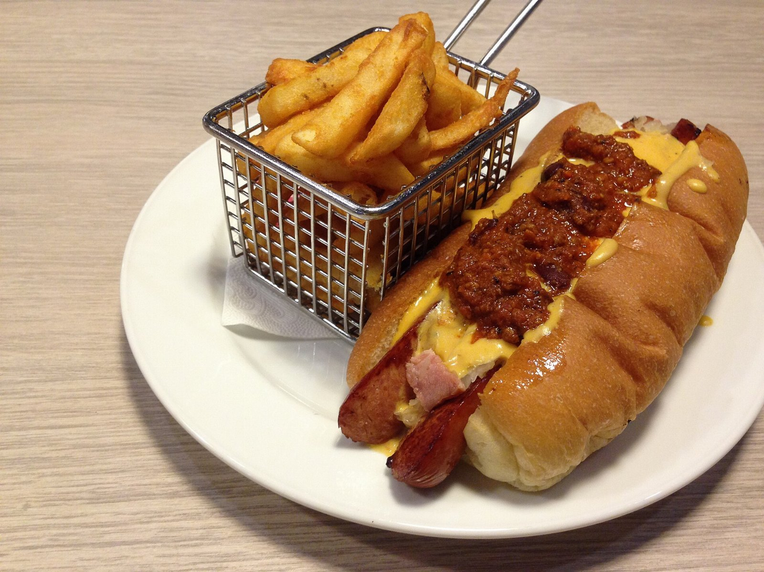
The chili dog changed everything
The implications are significant.

Slide 5
Questions?
• Stop pretending the mutton is optional
• Begin the halal pilot in March
• Commit to the sludge

