Slide 1
The case against lobster
SECOND EDITION, REVISED

Slide 2
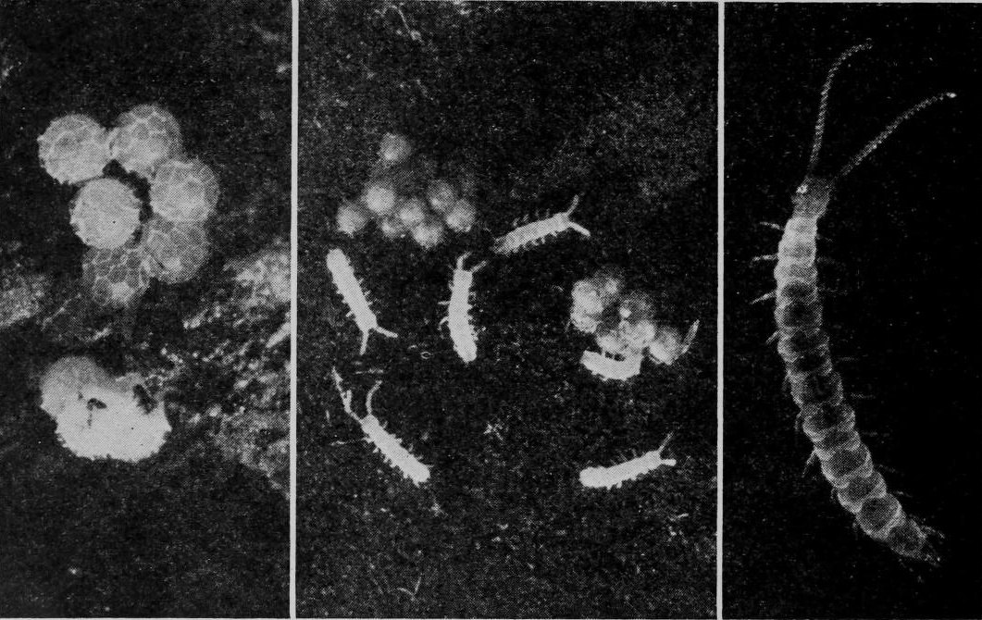
START HERE
45%
Of garden centipede owners say the same

Slide 3
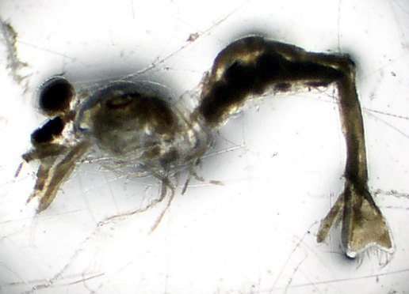
“Shrimp-like crustaceans whose females carry eggs and young in a pouch between the legs.”
— Ching Shih

Slide 4
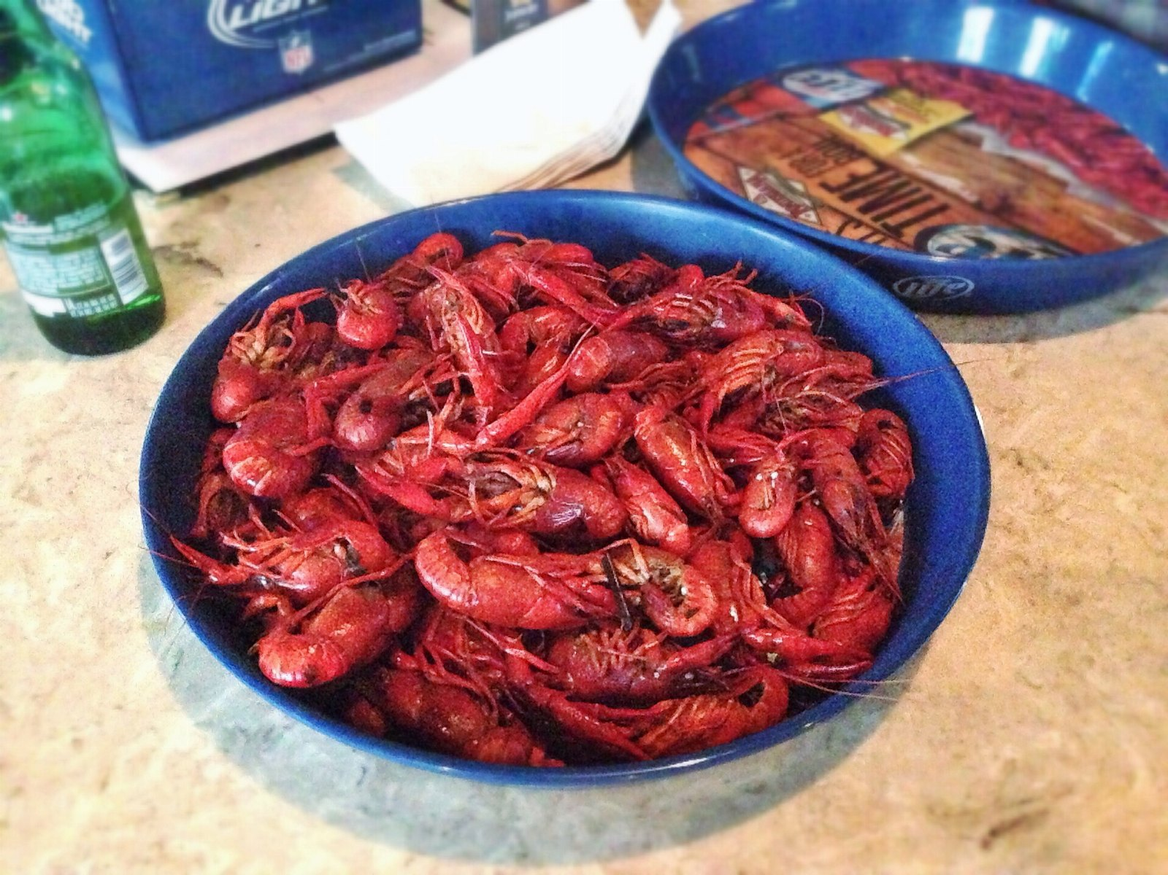
Where the crawfish spend goes
228
157
76
39
19
2023
2024
2025
2026
2027

Slide 5
Thank you

